Slide 1
Generative Modeling II
Diffusion Seminar (Week3)
In-depth VAE and Introduction to DDPM
Jaeik Kim
SNU AIDAS Lab

Slide 2
Recap: VAE

Slide 3
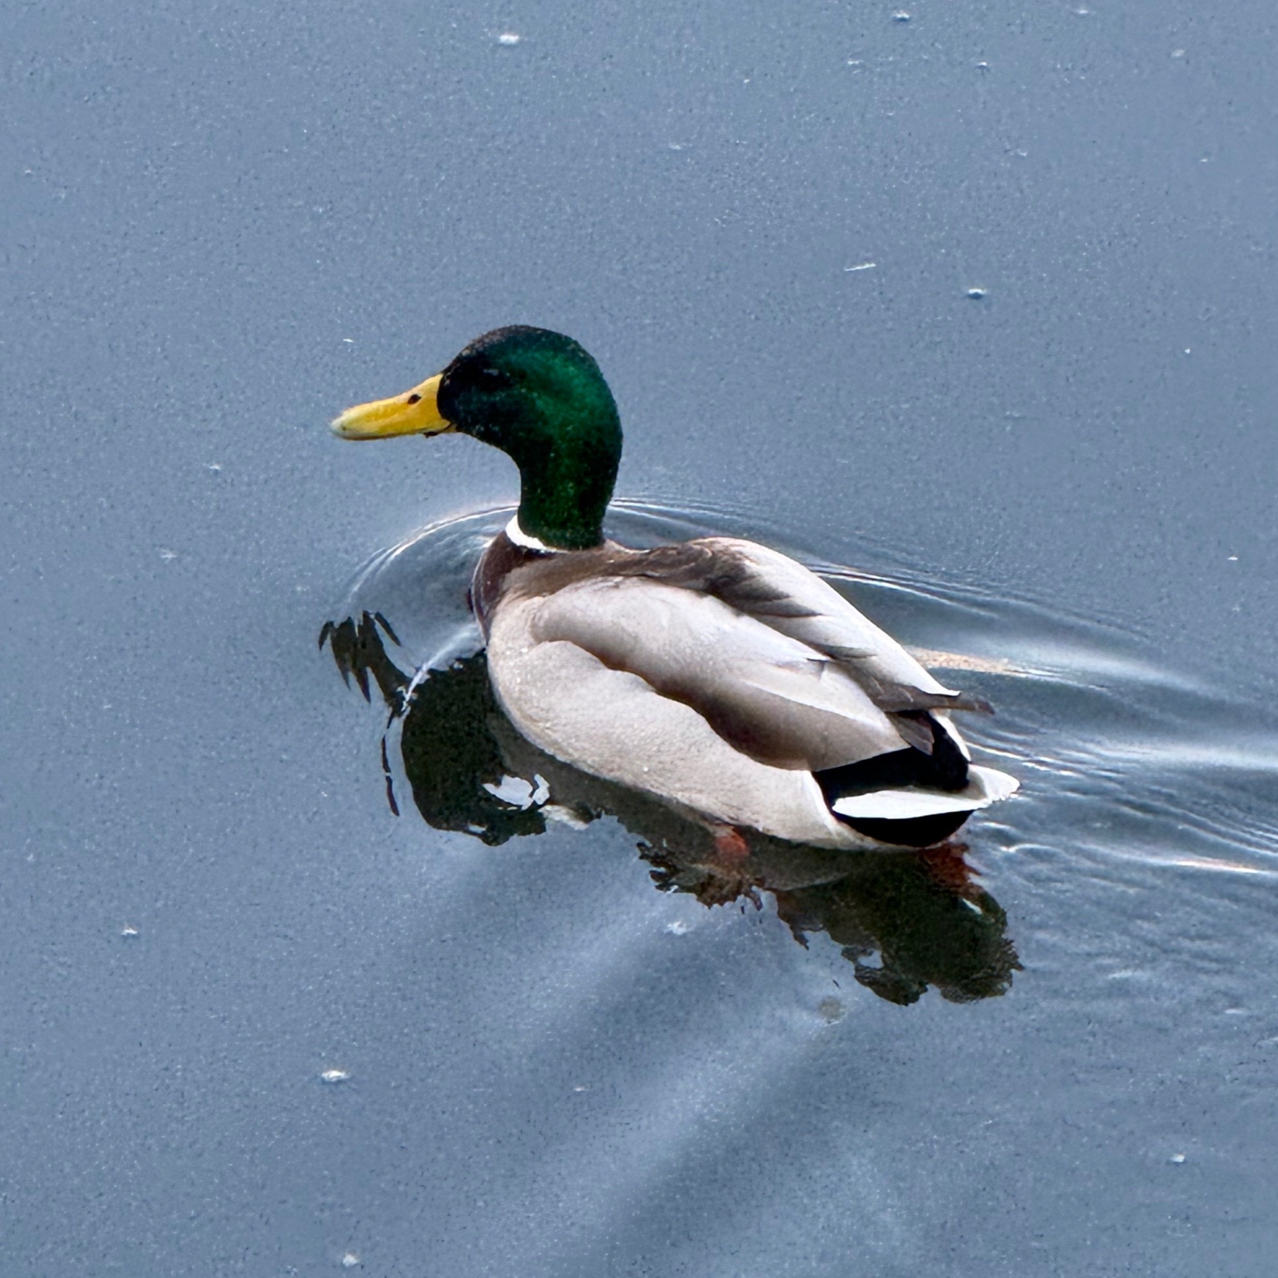
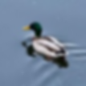
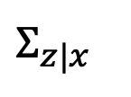
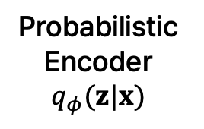
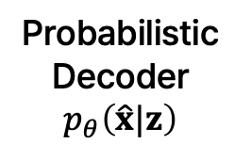



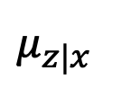
Previous Seminar - VAE
Recap: VAE
Probabilistic
Encoder
$$q_{φ}(z|x)$$
$$Σ_{z|x}$$
Probabilistic
Decoder
$$p_{θ}\left(\hat{x}|z\right)$$
$$z$$
$$μ_{z|x}$$
Image $x$
Reconstructed image $\hat{x}$

Slide 4
Previous Seminar - VAE
Recap: VAE
Objective: $\log{p_{θ}\left(x\right)}≥𝔼_{z}\left[\log{p_{θ}\left(x|z\right)}\right]−D_{KL}\left(q_{φ}\left(z | x\right)||p\left(z\right)\right)$
Probabilistic
Encoder
$$q_{φ}(z|x)$$
$$Σ_{z|x}$$
Probabilistic
Decoder
$$p_{θ}\left(\hat{x}|z\right)$$
$$z$$
$$μ_{z|x}$$
Image $x$
Reconstructed image $\hat{x}$

Slide 5
Previous Seminar - VAE
Recap: VAE
Reconstruction Term
Objective: $\log{p_{θ}\left(x\right)}≥𝔼_{z}\left[\log{p_{θ}\left(x|z\right)}\right]−D_{KL}\left(q_{φ}\left(z | x\right)||p\left(z\right)\right)$
Probabilistic
Encoder
$$q_{φ}(z|x)$$
$$Σ_{z|x}$$
Probabilistic
Decoder
$$p_{θ}\left(\hat{x}|z\right)$$
$$z$$
$$μ_{z|x}$$
Image $x$
Reconstructed image $\hat{x}$

Slide 6
Previous Seminar - VAE
Recap: VAE
Reconstruction Term
Prior Fitting Term = Regularization Term
Objective: $\log{p_{θ}\left(x\right)}≥𝔼_{z}\left[\log{p_{θ}\left(x|z\right)}\right]−D_{KL}\left(q_{φ}\left(z | x\right)||p\left(z\right)\right)$
Probabilistic
Encoder
$$q_{φ}(z|x)$$
$$Σ_{z|x}$$
Probabilistic
Decoder
$$p_{θ}\left(\hat{x}|z\right)$$
$$z$$
$$μ_{z|x}$$
Image $x$
Reconstructed image $\hat{x}$

Slide 7
Previous Seminar - VAE
Recap: VAE
How can we optimize VAE?
Probabilistic
Encoder
$$q_{φ}(z|x)$$
$$Σ_{z|x}$$
Probabilistic
Decoder
$$p_{θ}\left(\hat{x}|z\right)$$
$$z$$
$$μ_{z|x}$$
Image $x$
Reconstructed image $\hat{x}$

Slide 8
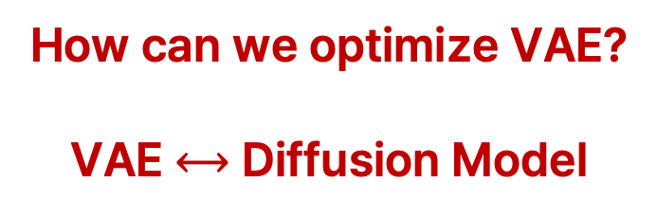
Previous Seminar - VAE
Recap: VAE
How can we optimize VAE?
VAE $⟷$ Diffusion Model
Probabilistic
Encoder
$$q_{φ}(z|x)$$
$$Σ_{z|x}$$
Probabilistic
Decoder
$$p_{θ}\left(\hat{x}|z\right)$$
$$z$$
$$μ_{z|x}$$
Image $x$
Reconstructed image $\hat{x}$

Slide 9
Today
Basics: Likelihood, MLE, MAP, Variational Inference
Deep dive into VAE: Optimization and Generation
DDPM(Denoising Diffusion Probabilistic Model) Overview

Slide 10
Basics

Slide 11
Likelihood
Basics
Likelihood measures how well a statistical model explains observed data by calculating the probability of seeing that data under different(i.e., unknown) parameter values of the model.

Slide 12
Likelihood
Basics
Likelihood measures how well a statistical model explains observed data by calculating the probability of seeing that data under different(i.e., unknown) parameter values of the model.
= How likely it is to generate the observed data?

Slide 13
Likelihood vs. Probability
Basics

Slide 14
Likelihood vs. Probability
Basics
Likelihood
Probability

Slide 15
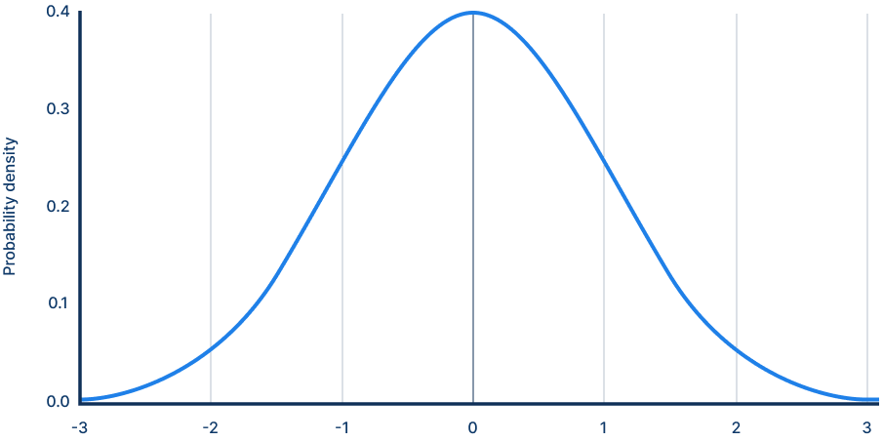

Likelihood vs. Probability
Basics
Likelihood
Probability
$$θ=(μ, σ^{2})$$

Slide 16
Likelihood vs. Probability
Basics
Likelihood
Probability
$$θ=(μ, σ^{2})$$
Observed data

Slide 17
Likelihood vs. Probability
Basics
Likelihood
Probability
$$θ=(μ, σ^{2})$$
Observed data

Slide 18

Likelihood vs. Probability
Basics
Likelihood
Probability
$$θ=(μ, σ^{2})$$
Observed data
$$P\left(x|θ\right)=0.24$$

Slide 19

Likelihood vs. Probability
Basics
Likelihood
Probability
$$θ=(μ, σ^{2})$$
$$θ=(μ, σ^{2})$$
Observed data
$$P\left(x|θ\right)=0.24$$

Slide 20
Likelihood vs. Probability
Basics
Likelihood
Probability
$$θ=(μ, σ^{2})$$
$$θ=(μ, σ^{2})$$
Observed data
Expected event
$$P\left(x|θ\right)=0.24$$

Slide 21

Likelihood vs. Probability
Basics
Likelihood
Probability
$$θ=(μ, σ^{2})$$
$$θ=(μ, σ^{2})$$
Observed data
Expected event
$$P\left(x|θ\right)=0.24$$
$$P\left(x|θ\right)=0.21$$

Slide 22


Likelihood vs. Probability
Basics
Likelihood
Probability
Want to find
Fixed
$$θ=(μ, σ^{2})$$
$$θ=(μ, σ^{2})$$
Observed data
Expected event
$$P\left(x|θ\right)=0.24$$
$$P\left(x|θ\right)=0.21$$

Slide 23
Maximum Likelihood Estimation(MLE)
Basics
MLE aims to estimate the parameters of a probability distribution by finding the parameter values that maximize the likelihood of the observed data.

Slide 24
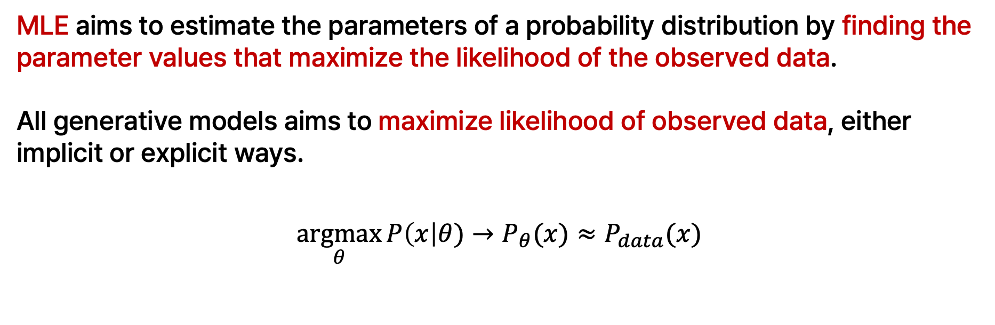
Maximum Likelihood Estimation(MLE)
Basics
MLE aims to estimate the parameters of a probability distribution by finding the parameter values that maximize the likelihood of the observed data.
All generative models aims to maximize likelihood of observed data, either implicit or explicit ways.
$$\underset{θ}{argmax}{P\left(x\right|θ)}→P_{θ}(x)≈P_{data}(x)$$

Slide 25
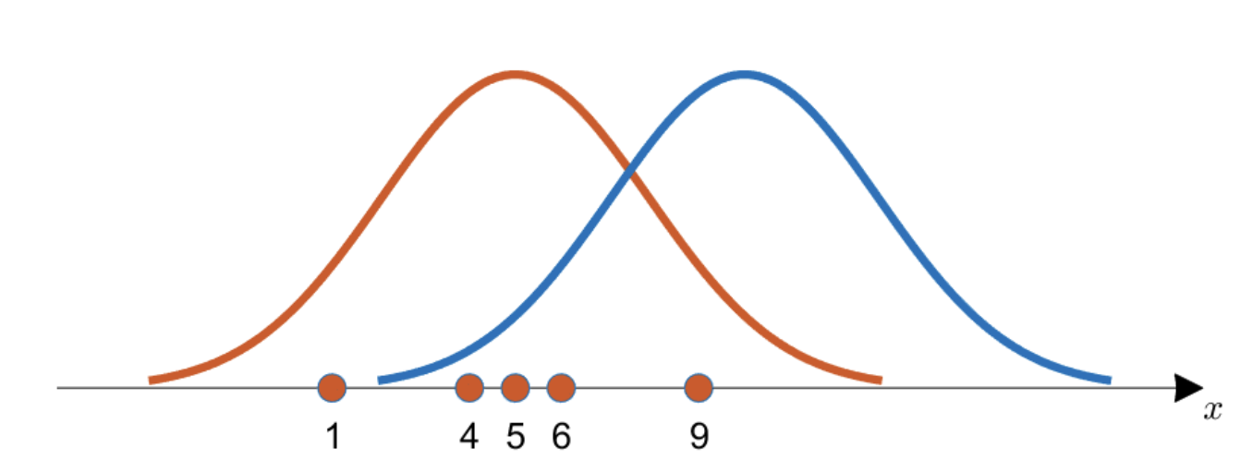
Maximum Likelihood Estimation(MLE)
Basics
MLE aims to estimate the parameters of a probability distribution by finding the parameter values that maximize the likelihood of the observed data.
All generative models aims to maximize likelihood of observed data, either implicit or explicit ways.

Slide 26
Maximum Likelihood Estimation(MLE)
Basics
MLE aims to estimate the parameters of a probability distribution by finding the parameter values that maximize the likelihood of the observed data.
All generative models aims to maximize likelihood of observed data, either implicit or explicit ways.
Maximizes likelihood

Slide 27

Maximum Likelihood Estimation(MLE)
Basics
MLE:
$$\underset{θ}{argmax}{P\left(x\right|θ)}→P_{θ}\left(x\right)≈P_{data}\left(x\right)$$

Slide 28
Maximum Likelihood Estimation(MLE)
Basics
MLE:
$$\underset{θ}{argmax}{P\left(x\right|θ)}→P_{θ}\left(x\right)≈P_{data}\left(x\right)$$
Overfitting to observed data

Slide 29
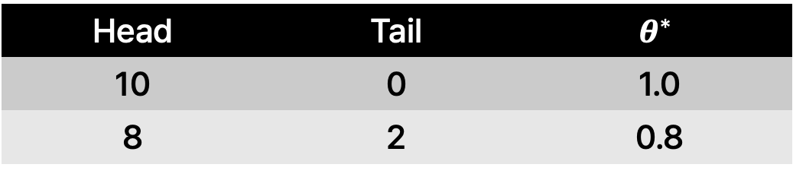
Maximum Likelihood Estimation(MLE)
Basics
MLE:
$$\underset{θ}{argmax}{P\left(x\right|θ)}→P_{θ}\left(x\right)≈P_{data}\left(x\right)$$
Overfitting to observed data
Example: Coin flip
Head | Tail | $$θ^{∗}$$
10 | 0 | 1.0
8 | 2 | 0.8

Slide 30
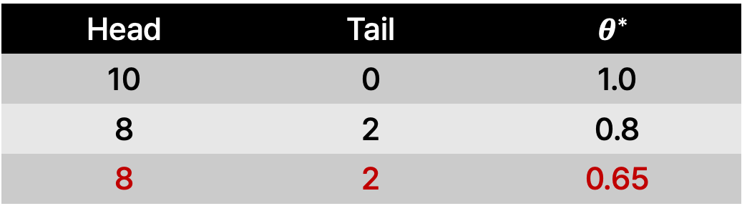
Maximum Likelihood Estimation(MLE)
Basics
MLE:
$$\underset{θ}{argmax}{P\left(x\right|θ)}→P_{θ}\left(x\right)≈P_{data}\left(x\right)$$
Overfitting to observed data
Example: Coin flip
Head | Tail | $$θ^{∗}$$
10 | 0 | 1.0
8 | 2 | 0.8
8 | 2 | 0.65
More reasonable!

Slide 31

Maximum A Posterior(MAP)
Basics
MAP: Maximize posterior $P\left(θ\right|x)$
- What is the likely $θ$given data x?
- Evaluates how likely $θ$is to be correct, given the observed data.
Notes:
내가 가지고 있는 데이터 x가 가장 그럴듯하게 나올 수 있는 파라미터 θ는 무엇일까?
데이터를 관찰한 후, 이 데이터를 가장 잘 설명할 것이라고 생각되는 파라미터 θ에 대한 확률 분포

Slide 32
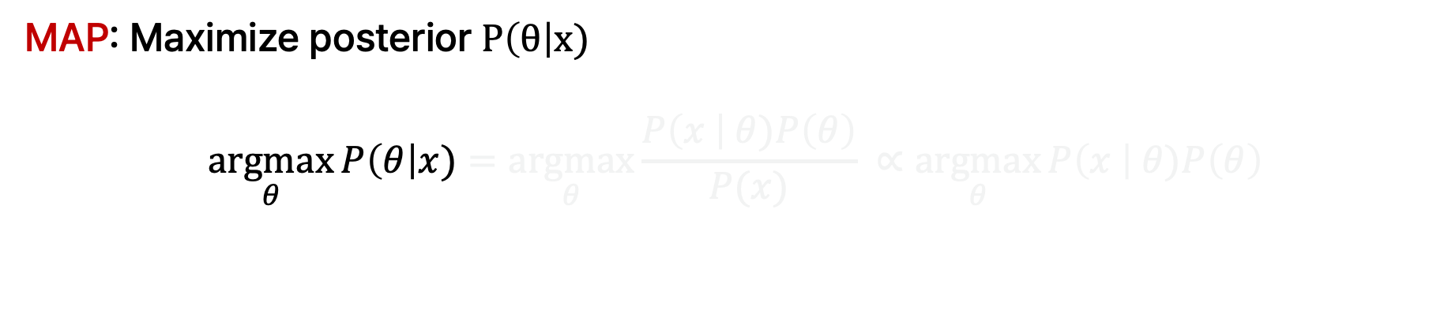
Maximum A Posterior(MAP)
Basics
MAP: Maximize posterior $P\left(θ\right|x)$
$$\underset{θ}{argmax}{P\left(θ\right|x)=\underset{θ}{argmax}{\frac{P\left(x \right| θ)P\left(θ\right)}{P(x)} }∝\underset{θ}{argmax}{P\left(x \right| θ)P\left(θ\right)}}$$

Slide 33
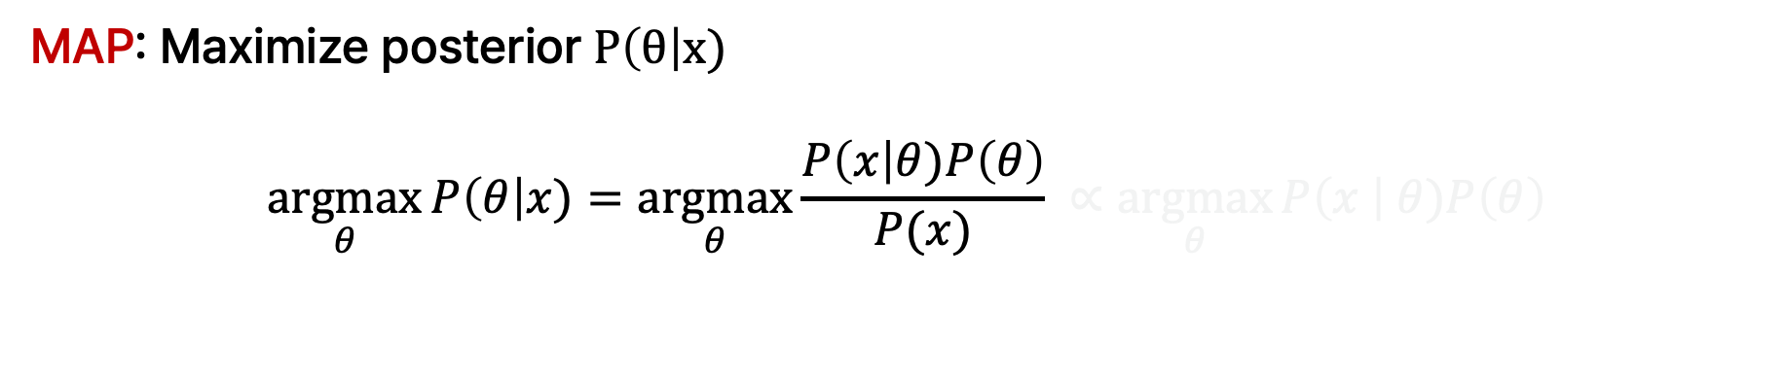
Maximum A Posterior(MAP)
Basics
MAP: Maximize posterior $P\left(θ\right|x)$
$$\underset{θ}{argmax}{P\left(θ\right|x)=\underset{θ}{argmax}{\frac{P\left(x\right|θ)P\left(θ\right)}{P(x)} }∝\underset{θ}{argmax}{P\left(x \right| θ)P\left(θ\right)}}$$
By Bayesian Rule

Slide 34
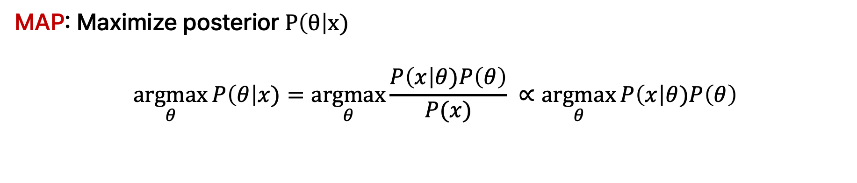
Maximum A Posterior(MAP)
Basics
MAP: Maximize posterior $P\left(θ\right|x)$
$$\underset{θ}{argmax}{P\left(θ\right|x)=\underset{θ}{argmax}{\frac{P\left(x\right|θ)P\left(θ\right)}{P(x)} }∝\underset{θ}{argmax}{P\left(x\right|θ)P\left(θ\right)}}$$
Constant

Slide 35
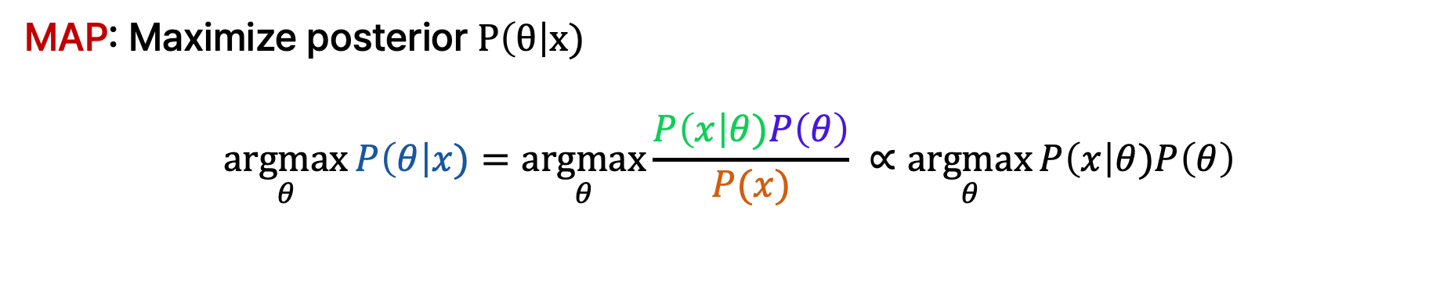
Maximum A Posterior(MAP)
Basics
MAP: Maximize posterior $P\left(θ\right|x)$
$$\underset{θ}{argmax}{P\left(θ\right|x)=\underset{θ}{argmax}{\frac{P\left(x\right|θ)P\left(θ\right)}{P(x)} }∝\underset{θ}{argmax}{P\left(x\right|θ)P\left(θ\right)}}$$
Likelihood
Prior
Posterior
Evidence

Slide 36
Maximum A Posterior(MAP)
Basics
MAP: Maximize posterior $P\left(θ\right|x)$
$$\underset{θ}{argmax}{P\left(θ\right|x)=\underset{θ}{argmax}{\frac{P\left(x\right|θ)P\left(θ\right)}{P(x)} }∝\underset{θ}{argmax}{P\left(x\right|θ)P\left(θ\right)}}$$
Likelihood
Prior
Posterior
Evidence
Example: Coin flip
Head | Tail | MLE | Prior | MAP
10 | 0 | 1.0 | 0.5 | 0.75
8 | 2 | 0.8 | 0.5 | 0.65

Slide 37
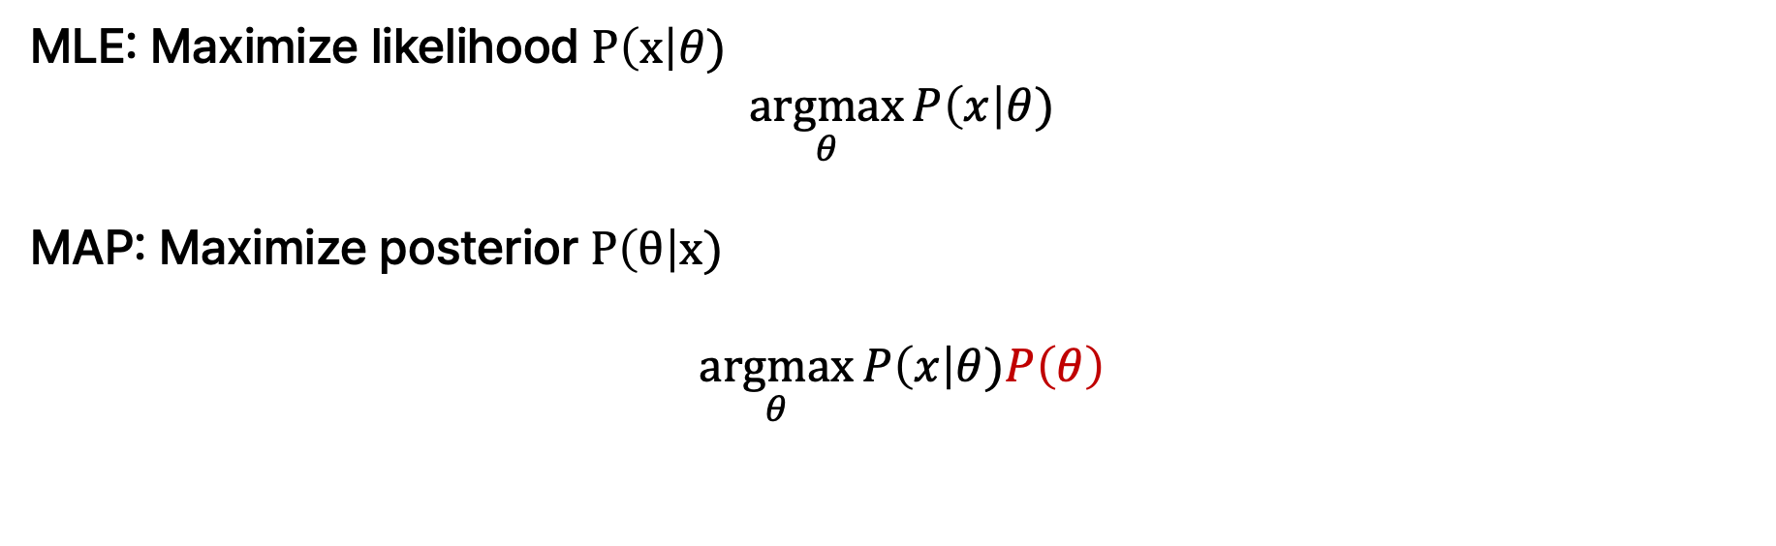
Relationship between MLE and MAP
Basics
MLE: Maximize likelihood $P\left(x\right|θ)$
$$\underset{θ}{argmax}{P\left(x\right|θ)}$$
MAP: Maximize posterior $P\left(θ\right|x)$
$$\underset{θ}{argmax}{P\left(x\right|θ)P\left(θ\right)}$$

Slide 38
Relationship between MLE and MAP
Basics
MLE: Maximize likelihood $P\left(x\right|θ)$
$$\underset{θ}{argmax}{P\left(x\right|θ)}$$
MAP: Maximize posterior $P\left(θ\right|x)$
$$\underset{θ}{argmax}{P\left(x\right|θ)P\left(θ\right)}$$
If $P\left(θ\right)$is uniform(i.e., constant), then MAP = MLE

Slide 39
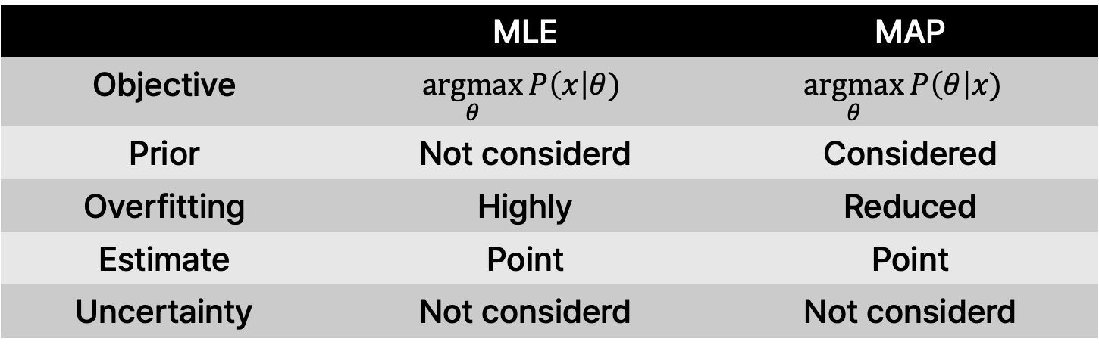
MLE and MAP
Basics
 | MLE | MAP
Objective | $$\underset{θ}{argmax}{P\left(x\right|θ)}$$ | $$\underset{θ}{argmax}{P\left(θ\right|x) }$$
Prior | Not considerd | Considered
Overfitting | Highly | Reduced
Estimate | Point | Point
Uncertainty | Not considerd | Not considerd

Slide 40
MLE and MAP
Basics
 | MLE | MAP
Objective | $$\underset{θ}{argmax}{P\left(x\right|θ)}$$ | $$\underset{θ}{argmax}{P\left(θ\right|x) }$$
Prior | Not considerd | Considered
Overfitting | Highly | Reduced
Estimate | Point | Point
Uncertainty | Not considerd | Not considerd
Why it is important?

Slide 41
MLE and MAP
Basics
 | MLE | MAP
Objective | $$\underset{θ}{argmax}{P\left(x\right|θ)}$$ | $$\underset{θ}{argmax}{P\left(θ\right|x) }$$
Prior | Not considerd | Considered
Overfitting | Highly | Reduced
Estimate | Point | Point
Uncertainty | Not considerd | Not considerd
Why it is important?
Reliability
Sample diversity(generative model)

Slide 42
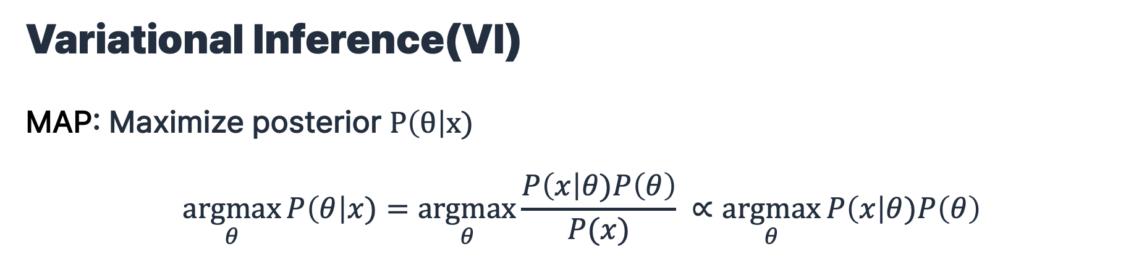
Variational Inference(VI)
MAP: Maximize posterior $P\left(θ\right|x)$
$$\underset{θ}{argmax}{P\left(θ\right|x)=\underset{θ}{argmax}{\frac{P\left(x\right|θ)P\left(θ\right)}{P(x)} }∝\underset{θ}{argmax}{P\left(x\right|θ)P\left(θ\right)}}$$
Basics

Slide 43
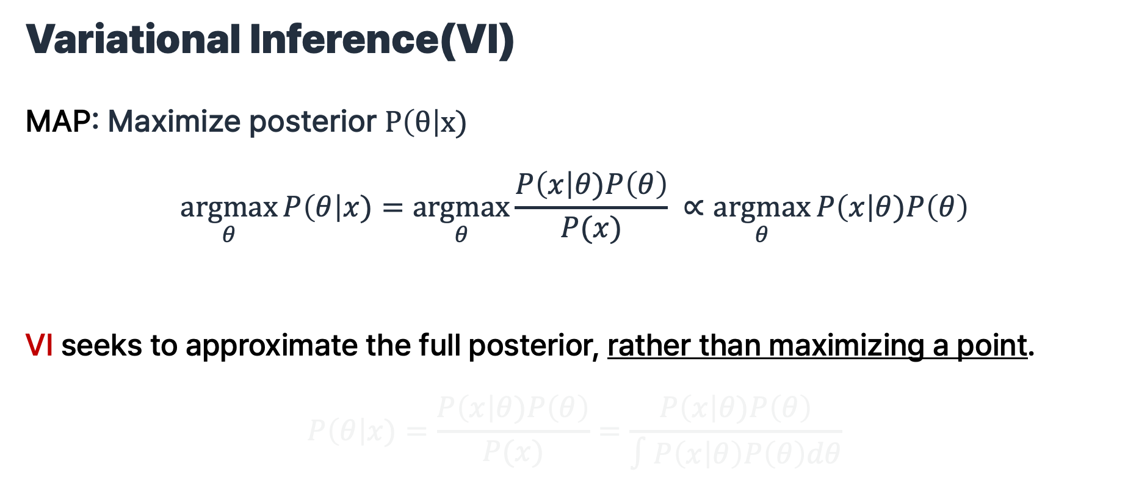
Variational Inference(VI)
MAP: Maximize posterior $P\left(θ\right|x)$
$$\underset{θ}{argmax}{P\left(θ\right|x)=\underset{θ}{argmax}{\frac{P\left(x\right|θ)P\left(θ\right)}{P(x)} }∝\underset{θ}{argmax}{P\left(x\right|θ)P\left(θ\right)}}$$
VI seeks to approximate the full posterior, rather than maximizing a point.
$$P\left(θ\right|x)=\frac{P\left(x\right|θ)P\left(θ\right)}{P(x)}=\frac{P\left(x\right|θ)P\left(θ\right)}{∫P\left(x | θ\right)P\left(θ\right)dθ}$$
Basics

Slide 44
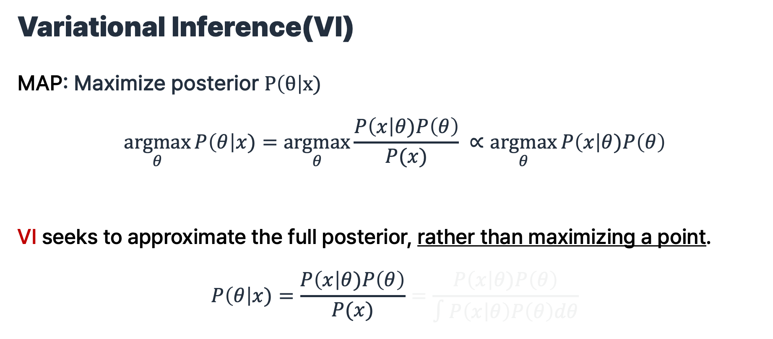
Variational Inference(VI)
MAP: Maximize posterior $P\left(θ\right|x)$
$$\underset{θ}{argmax}{P\left(θ\right|x)=\underset{θ}{argmax}{\frac{P\left(x\right|θ)P\left(θ\right)}{P(x)} }∝\underset{θ}{argmax}{P\left(x\right|θ)P\left(θ\right)}}$$
VI seeks to approximate the full posterior, rather than maximizing a point.
$$P\left(θ\right|x)=\frac{P\left(x\right|θ)P\left(θ\right)}{P(x)}=\frac{P\left(x\right|θ)P\left(θ\right)}{∫P\left(x | θ\right)P\left(θ\right)dθ}$$
Basics

Slide 45
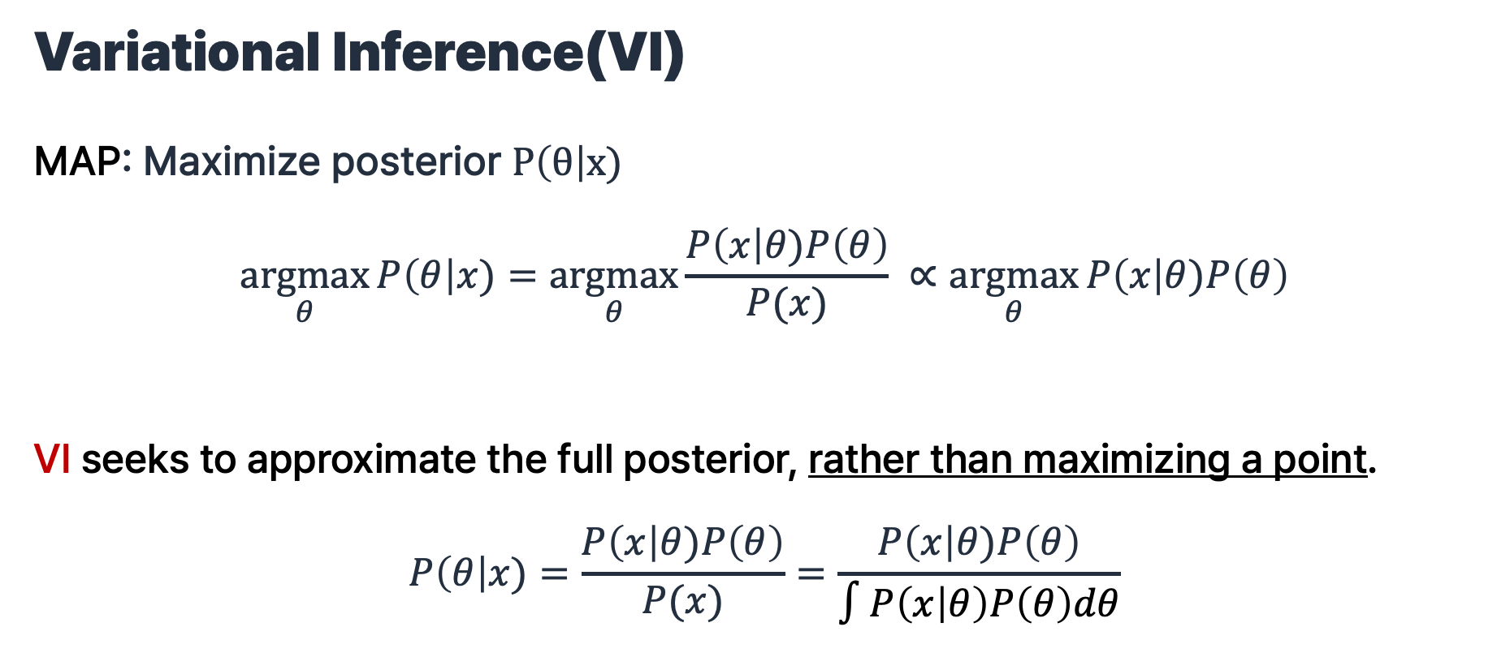
Variational Inference(VI)
MAP: Maximize posterior $P\left(θ\right|x)$
$$\underset{θ}{argmax}{P\left(θ\right|x)=\underset{θ}{argmax}{\frac{P\left(x\right|θ)P\left(θ\right)}{P(x)} }∝\underset{θ}{argmax}{P\left(x\right|θ)P\left(θ\right)}}$$
VI seeks to approximate the full posterior, rather than maximizing a point.
$$P\left(θ\right|x)=\frac{P\left(x\right|θ)P\left(θ\right)}{P(x)}=\frac{P\left(x\right|θ)P\left(θ\right)}{∫P\left(x | θ\right)P\left(θ\right)dθ}$$
Basics

Slide 46
Variational Inference(VI)
MAP: Maximize posterior $P\left(θ\right|x)$
$$\underset{θ}{argmax}{P\left(θ\right|x)=\underset{θ}{argmax}{\frac{P\left(x\right|θ)P\left(θ\right)}{P(x)} }∝\underset{θ}{argmax}{P\left(x\right|θ)P\left(θ\right)}}$$
VI seeks to approximate the full posterior, rather than maximizing a point.
$$P\left(θ\right|x)=\frac{P\left(x\right|θ)P\left(θ\right)}{P(x)}=\frac{P\left(x\right|θ)P\left(θ\right)}{∫P\left(x | θ\right)P\left(θ\right)dθ}$$
Basics
Evidence

Slide 47
Variational Inference(VI)
MAP: Maximize posterior $P\left(θ\right|x)$
$$\underset{θ}{argmax}{P\left(θ\right|x)=\underset{θ}{argmax}{\frac{P\left(x\right|θ)P\left(θ\right)}{P(x)} }∝\underset{θ}{argmax}{P\left(x\right|θ)P\left(θ\right)}}$$
VI seeks to approximate the full posterior, rather than maximizing a point.
$$P\left(θ\right|x)=\frac{P\left(x\right|θ)P\left(θ\right)}{P(x)}=\frac{P\left(x\right|θ)P\left(θ\right)}{∫P\left(x | θ\right)P\left(θ\right)dθ}$$
Basics
Intractable!

Slide 48
Variational Inference(VI)
Basics
        $P\left(θ\right|x)=\frac{P\left(x\right|θ)P\left(θ\right)}{P(x)}=\frac{P\left(x\right|θ)P\left(θ\right)}{∫P\left(x | θ\right)P\left(θ\right)dθ}$
Bayesian parameter inference

Slide 49
Variational Inference(VI)
Basics
        $P\left(θ\right|x)=\frac{P\left(x\right|θ)P\left(θ\right)}{P(x)}=\frac{P\left(x\right|θ)P\left(θ\right)}{∫P\left(x | θ\right)P\left(θ\right)dθ}$
Bayesian parameter inference
        $P\left(z\right|x)=\frac{P\left(x\right|z)P\left(z\right)}{P(x)}=\frac{P\left(x\right|z)P\left(z\right)}{∫P\left(x | z\right)P\left(z\right)dz}$
Latent variable inference
VAE, Diffusion

Slide 50
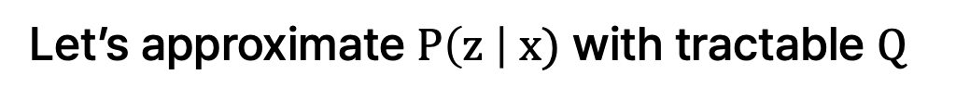
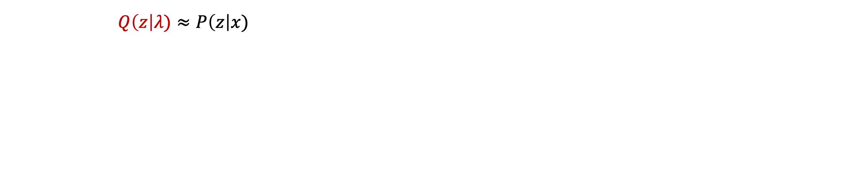
Variational Inference(VI)
Basics
        $Q\left(z\right|λ)≈P\left(z\right|x)$
Let’s approximate $P\left(z \right| x)$ with tractable $Q$

Slide 51

Variational Inference(VI)
Basics
        $Q\left(z\right|λ)≈P\left(z\right|x)$
$\min_{λ}{D_{KL}(Q\left(z\right|λ) || P\left(z\right|x))}$

Slide 52

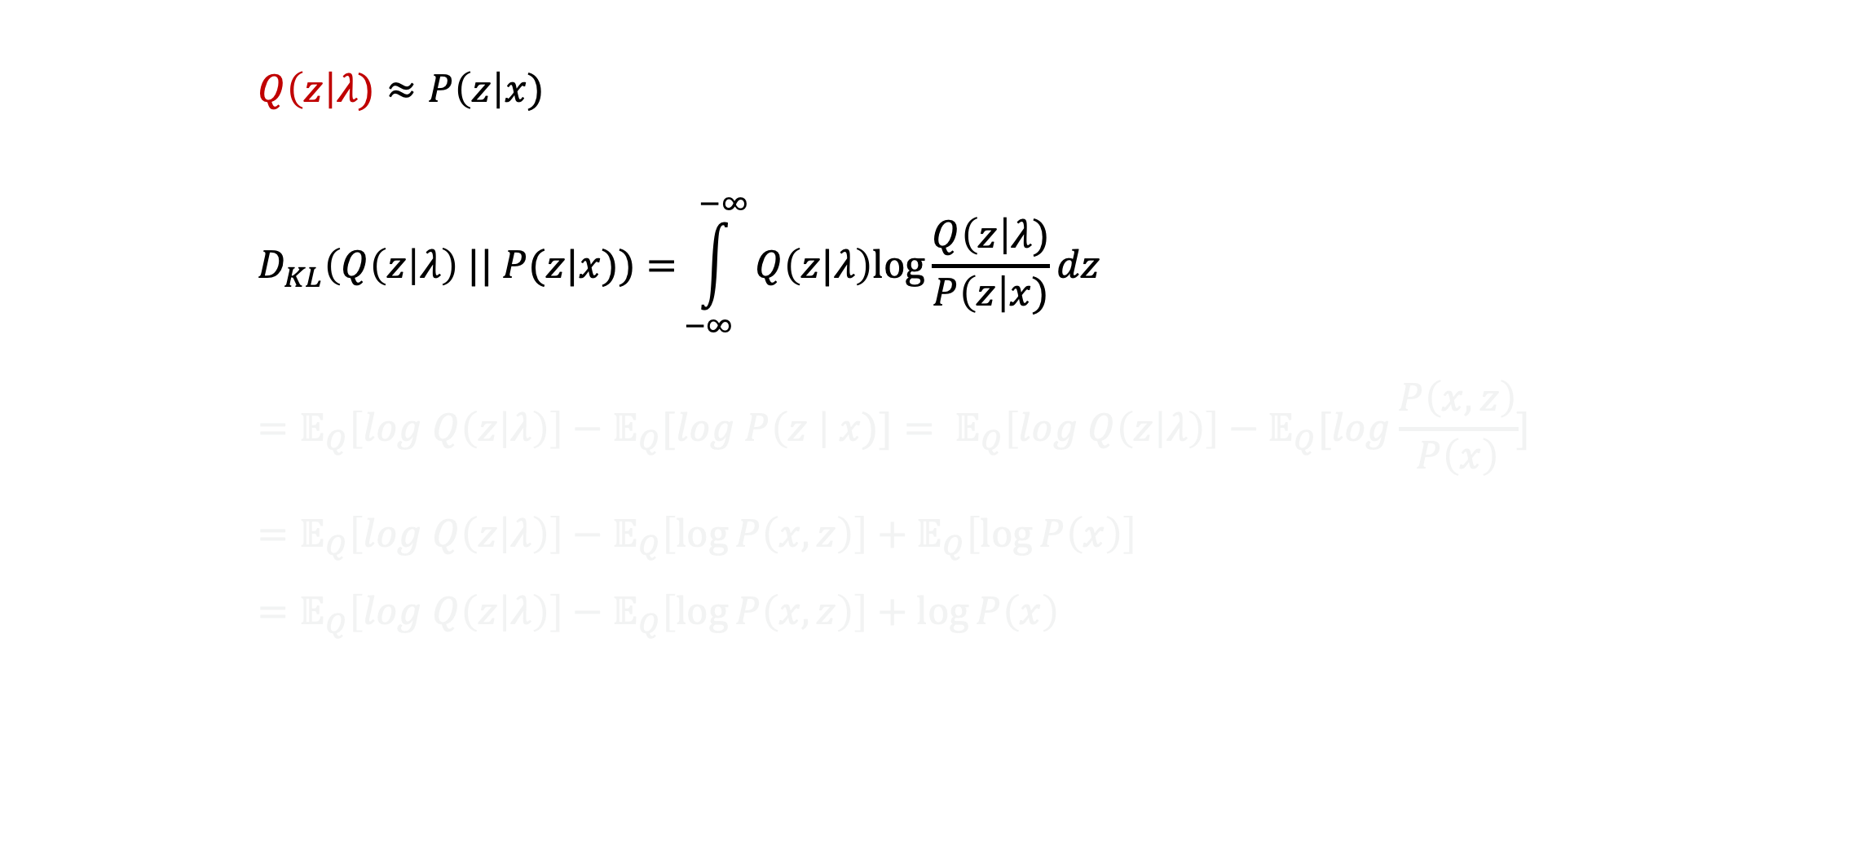
Variational Inference(VI)
Basics
        $Q\left(z\right|λ)≈P\left(z\right|x)$
        $$D_{KL}\left(Q\left(z\right|λ\right) || P(z|x))={\int_{−∞}^{−∞}{Q\left(z|λ\right)log\frac{Q\left(z\right|λ)}{P\left(z\right|x)}dz}} \\ =𝔼_{Q}\left[log Q\left(z | λ\right)\right]−𝔼_{Q}[log P\left(z \right| x)]= 𝔼_{Q}\left[log Q\left(z | λ\right)\right]−𝔼_{Q}[log\frac{P\left(x, z\right)}{P\left(x\right)}] \\ =𝔼_{Q}\left[log Q\left(z | λ\right)\right]−𝔼_{Q}\left[\log{P\left(x,z\right)}\right]+𝔼_{Q}\left[\log{P\left(x\right)}\right] \\ =𝔼_{Q}\left[log Q\left(z | λ\right)\right]−𝔼_{Q}\left[\log{P\left(x,z\right)}\right]+\log{P\left(x\right)}$$
$\min_{λ}{D_{KL}(Q\left(z\right|λ) || P\left(z\right|x))}$
$⋯$(By definition)

Slide 53
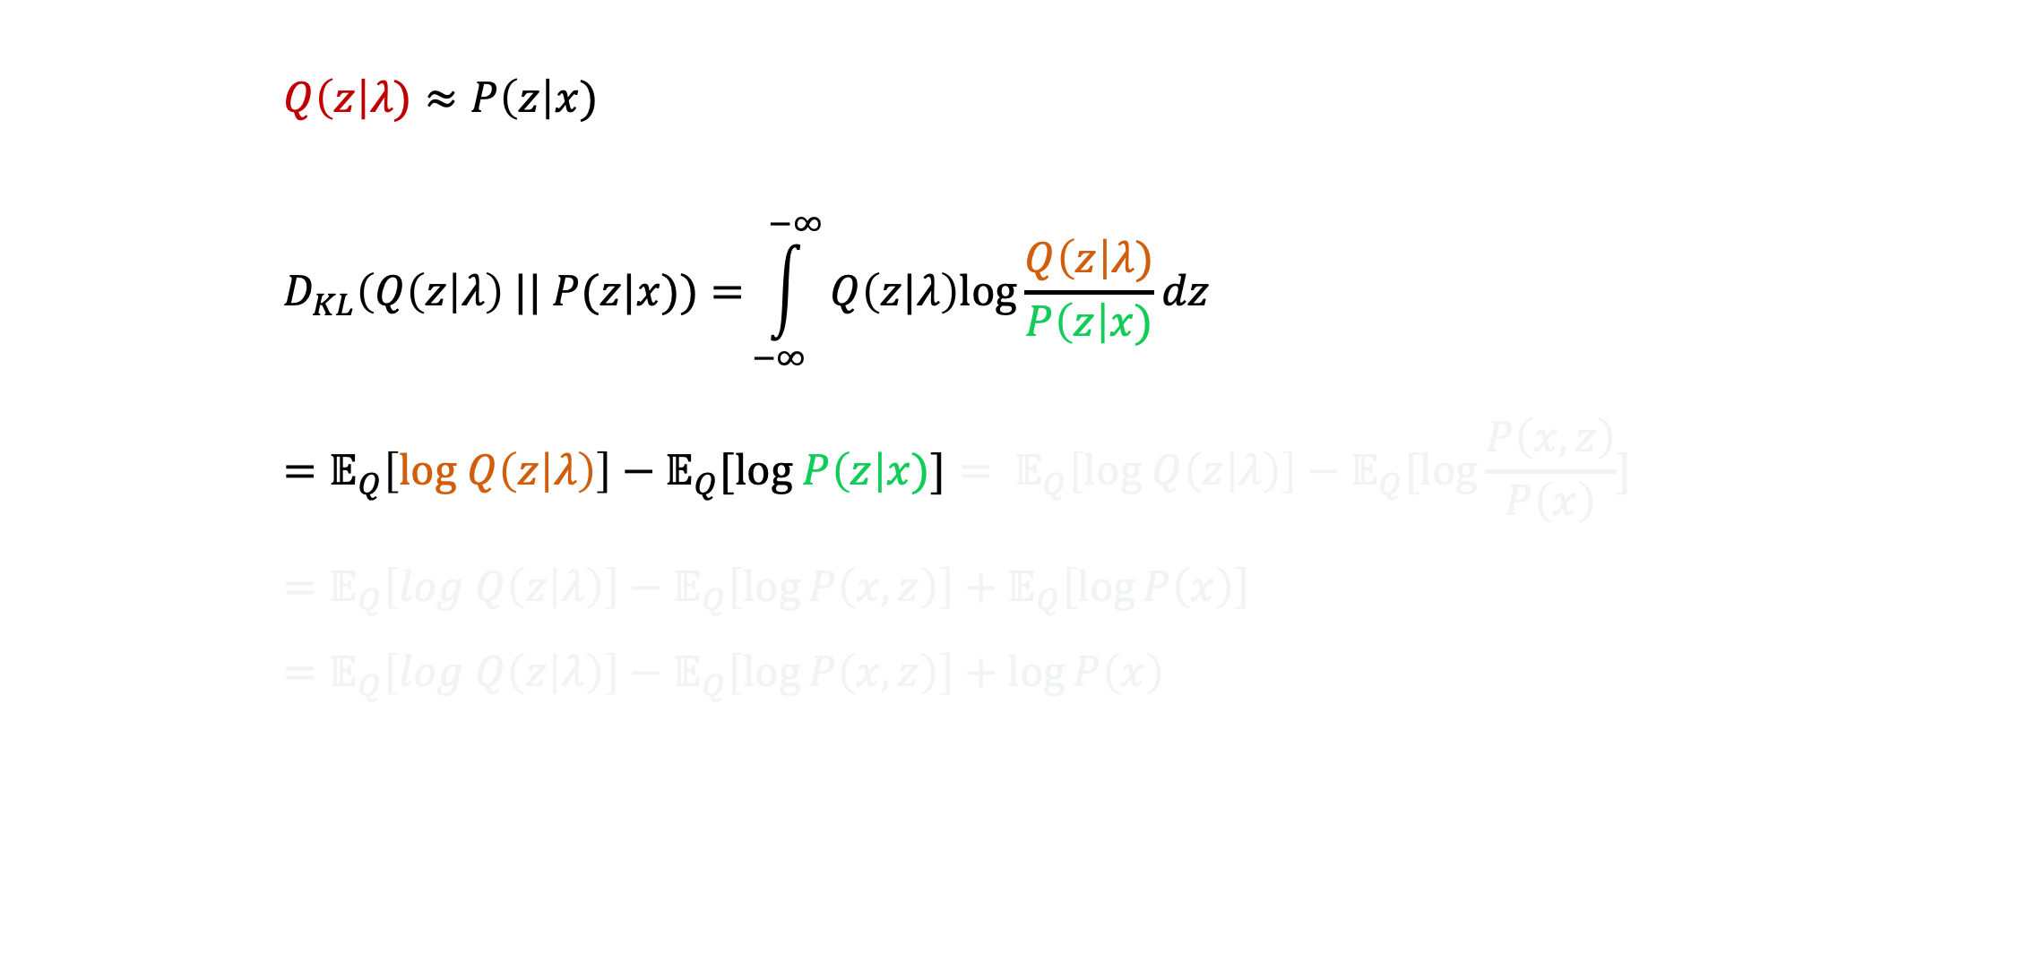
Variational Inference(VI)
Basics
        $Q\left(z\right|λ)≈P\left(z\right|x)$
        $$D_{KL}\left(Q\left(z\right|λ\right) || P(z|x))={\int_{−∞}^{−∞}{Q\left(z|λ\right)log\frac{Q\left(z\right|λ)}{P\left(z\right|x)}}}dz \\ =𝔼_{Q}\left[log Q\left(z | λ\right)\right]−𝔼_{Q}[log P\left(z\right|x)]= 𝔼_{Q}\left[log Q\left(z | λ\right)\right]−𝔼_{Q}[log\frac{P\left(x, z\right)}{P\left(x\right)}] \\ =𝔼_{Q}\left[log Q\left(z | λ\right)\right]−𝔼_{Q}\left[\log{P\left(x,z\right)}\right]+𝔼_{Q}\left[\log{P\left(x\right)}\right] \\ =𝔼_{Q}\left[log Q\left(z | λ\right)\right]−𝔼_{Q}\left[\log{P\left(x,z\right)}\right]+\log{P\left(x\right)}$$
$\min_{λ}{D_{KL}(Q\left(z\right|λ) || P\left(z\right|x))}$
$⋯$(By definition)

Slide 54
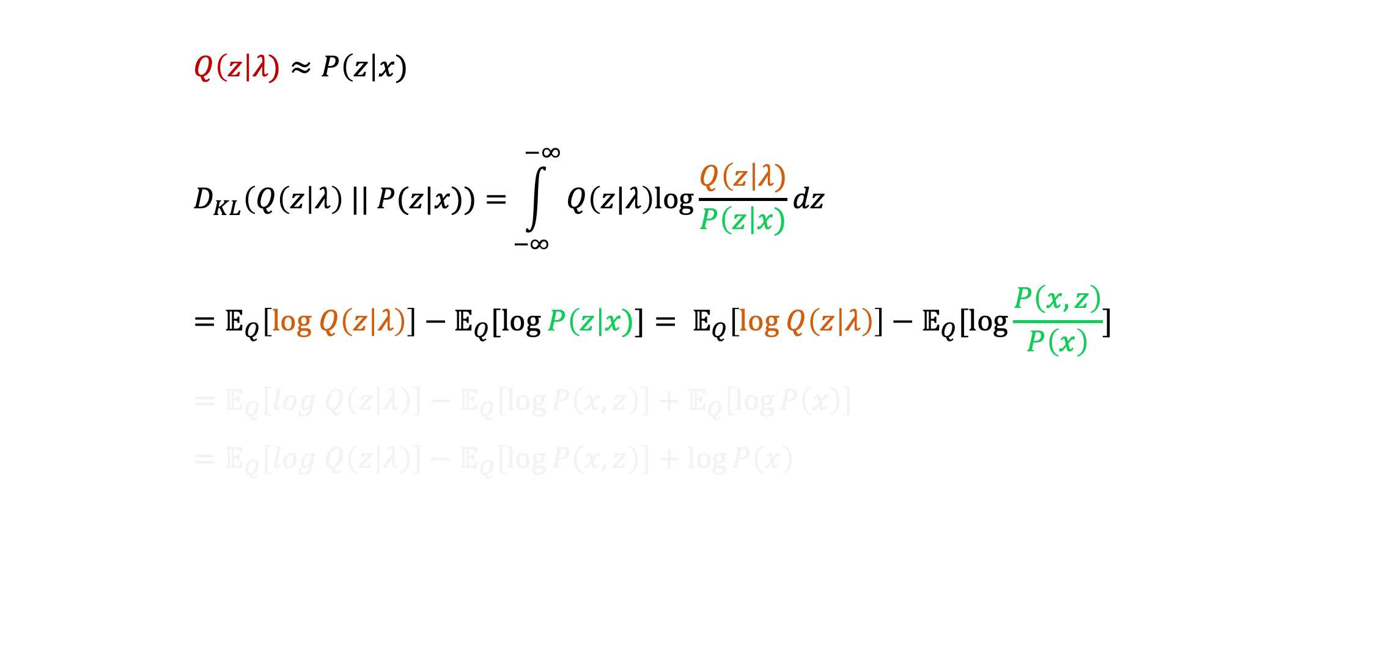

Variational Inference(VI)
Basics
        $Q\left(z\right|λ)≈P\left(z\right|x)$
        $$D_{KL}\left(Q\left(z\right|λ\right) || P(z|x))={\int_{−∞}^{−∞}{Q\left(z|λ\right)log\frac{Q\left(z\right|λ)}{P\left(z\right|x)}dz}} \\ =𝔼_{Q}\left[log Q\left(z | λ\right)\right]−𝔼_{Q}[log P\left(z\right|x)]= 𝔼_{Q}\left[log Q\left(z | λ\right)\right]−𝔼_{Q}[log\frac{P\left(x, z\right)}{P\left(x\right)}] \\ =𝔼_{Q}\left[log Q\left(z | λ\right)\right]−𝔼_{Q}\left[\log{P\left(x,z\right)}\right]+𝔼_{Q}\left[\log{P\left(x\right)}\right] \\ =𝔼_{Q}\left[log Q\left(z | λ\right)\right]−𝔼_{Q}\left[\log{P\left(x,z\right)}\right]+\log{P\left(x\right)}$$
$\min_{λ}{D_{KL}(Q\left(z\right|λ) || P\left(z\right|x))}$
$⋯$(By definition)
$⋯$(By Bayesian)

Slide 55
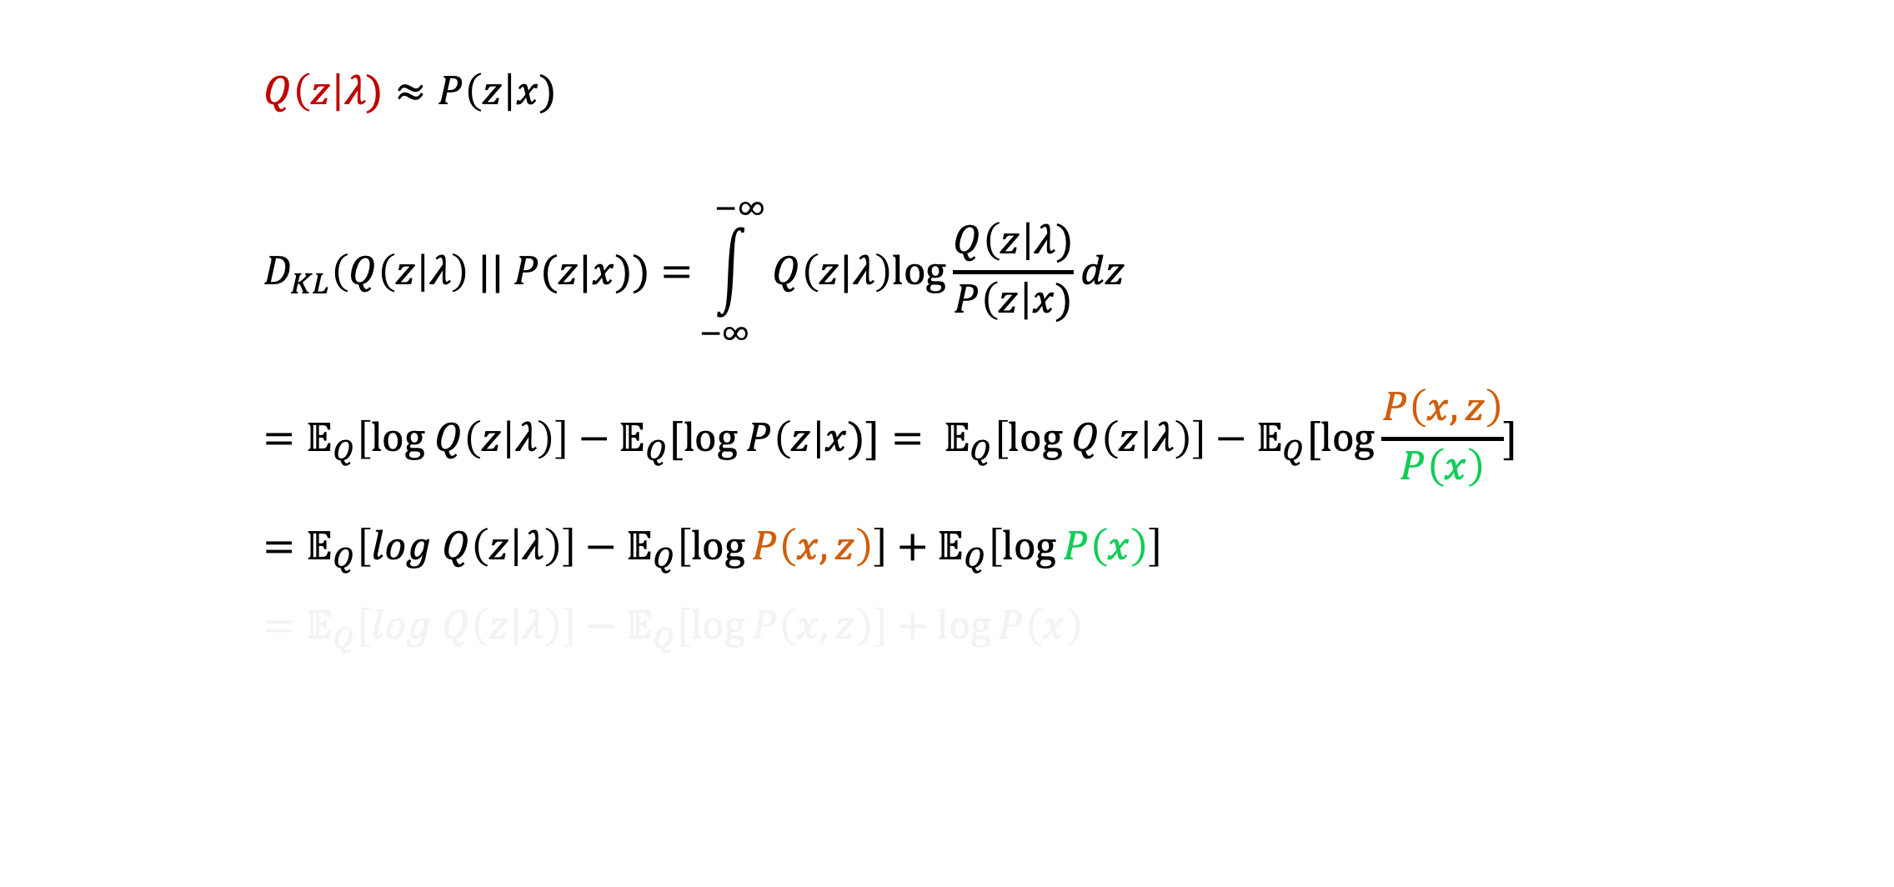
Variational Inference(VI)
Basics
        $Q\left(z\right|λ)≈P\left(z\right|x)$
        $$D_{KL}\left(Q\left(z\right|λ\right) || P(z|x))={\int_{−∞}^{−∞}{Q\left(z|λ\right)log\frac{Q\left(z\right|λ)}{P\left(z\right|x)}}}dz \\ =𝔼_{Q}\left[log Q\left(z | λ\right)\right]−𝔼_{Q}[log P\left(z\right|x)]= 𝔼_{Q}\left[log Q\left(z | λ\right)\right]−𝔼_{Q}[log\frac{P\left(x, z\right)}{P\left(x\right)}] \\ =𝔼_{Q}\left[log Q\left(z | λ\right)\right]−𝔼_{Q}\left[\log{P\left(x,z\right)}\right]+𝔼_{Q}\left[\log{P\left(x\right)}\right] \\ =𝔼_{Q}\left[log Q\left(z | λ\right)\right]−𝔼_{Q}\left[\log{P\left(x,z\right)}\right]+\log{P\left(x\right)}$$
$\min_{λ}{D_{KL}(Q\left(z\right|λ) || P\left(z\right|x))}$
$⋯$(By definition)
$⋯$(By Bayesian)

Slide 56
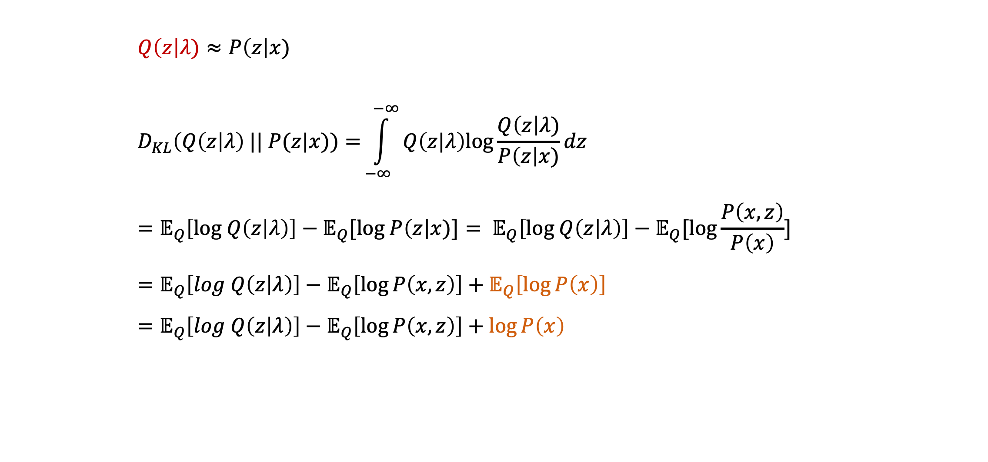
Variational Inference(VI)
Basics
        $Q\left(z\right|λ)≈P\left(z\right|x)$
        $$D_{KL}\left(Q\left(z\right|λ\right) || P(z|x))={\int_{−∞}^{−∞}{Q\left(z|λ\right)log\frac{Q\left(z\right|λ)}{P\left(z\right|x)}}}dz \\ =𝔼_{Q}\left[log Q\left(z | λ\right)\right]−𝔼_{Q}[log P\left(z\right|x)]= 𝔼_{Q}\left[log Q\left(z | λ\right)\right]−𝔼_{Q}[log\frac{P\left(x, z\right)}{P\left(x\right)}] \\ =𝔼_{Q}\left[log Q\left(z | λ\right)\right]−𝔼_{Q}\left[\log{P\left(x,z\right)}\right]+𝔼_{Q}\left[\log{P\left(x\right)}\right] \\ =𝔼_{Q}\left[log Q\left(z | λ\right)\right]−𝔼_{Q}\left[\log{P\left(x,z\right)}\right]+\log{P\left(x\right)}$$
$\min_{λ}{D_{KL}(Q\left(z\right|λ) || P\left(z\right|x))}$
$⋯$(By definition)
$⋯$(By Bayesian)

Slide 57
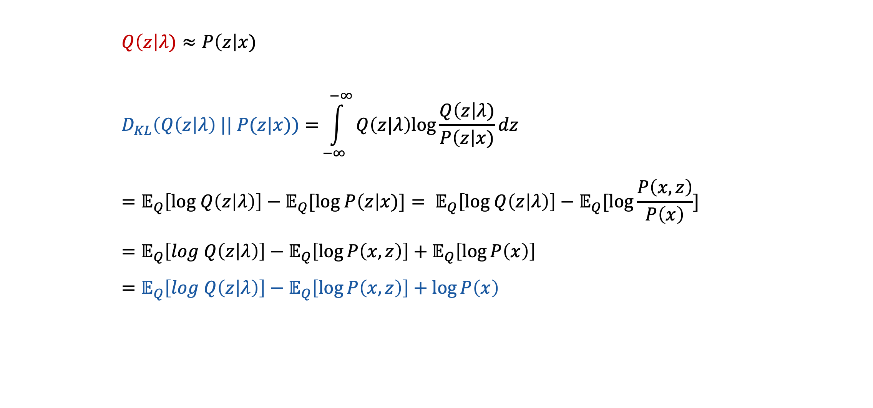
Variational Inference(VI)
Basics
        $Q\left(z\right|λ)≈P\left(z\right|x)$
        $$D_{KL}\left(Q\left(z\right|λ\right) || P(z|x))={\int_{−∞}^{−∞}{Q\left(z|λ\right)log\frac{Q\left(z\right|λ)}{P\left(z\right|x)}}}dz \\ =𝔼_{Q}\left[log Q\left(z | λ\right)\right]−𝔼_{Q}[log P\left(z\right|x)]= 𝔼_{Q}\left[log Q\left(z | λ\right)\right]−𝔼_{Q}[log\frac{P\left(x, z\right)}{P\left(x\right)}] \\ =𝔼_{Q}\left[log Q\left(z | λ\right)\right]−𝔼_{Q}\left[\log{P\left(x,z\right)}\right]+𝔼_{Q}\left[\log{P\left(x\right)}\right] \\ =𝔼_{Q}\left[log Q\left(z | λ\right)\right]−𝔼_{Q}\left[\log{P\left(x,z\right)}\right]+\log{P\left(x\right)}$$
$\min_{λ}{D_{KL}(Q\left(z\right|λ) || P\left(z\right|x))}$
$⋯$(By definition)
$⋯$(By Bayesian)

Slide 58
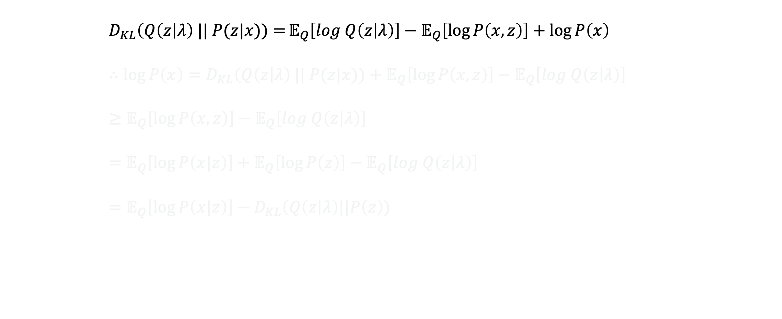
Variational Inference(VI)
Basics
        $$D_{KL}\left(Q\left(z\right|λ\right) || P(z|x))={𝔼_{Q}\left[log Q\left(z | λ\right)\right]−𝔼_{Q}\left[\log{P\left(x,z\right)}\right]+\log{P\left(x\right)} } \\ ∴\log{P\left(x\right)}=D_{KL}\left(Q\left(z\right|λ\right) || P(z|x))+𝔼_{Q}\left[\log{P\left(x,z\right)}\right]−𝔼_{Q}\left[log Q\left(z | λ\right)\right]≥𝔼_{Q}\left[\log{P\left(x,z\right)}\right]−𝔼_{Q}\left[log Q\left(z | λ\right)\right] \\ =𝔼_{Q}\left[\log{P\left(x|z\right)}\right]+𝔼_{Q}\left[\log{P\left(z\right)}\right]−𝔼_{Q}\left[log Q\left(z | λ\right)\right] \\ =𝔼_{Q}\left[\log{P\left(x|z\right)}\right]−D_{KL}\left(Q\left(z\right|λ\right)||P\left(z\right))$$

Slide 59
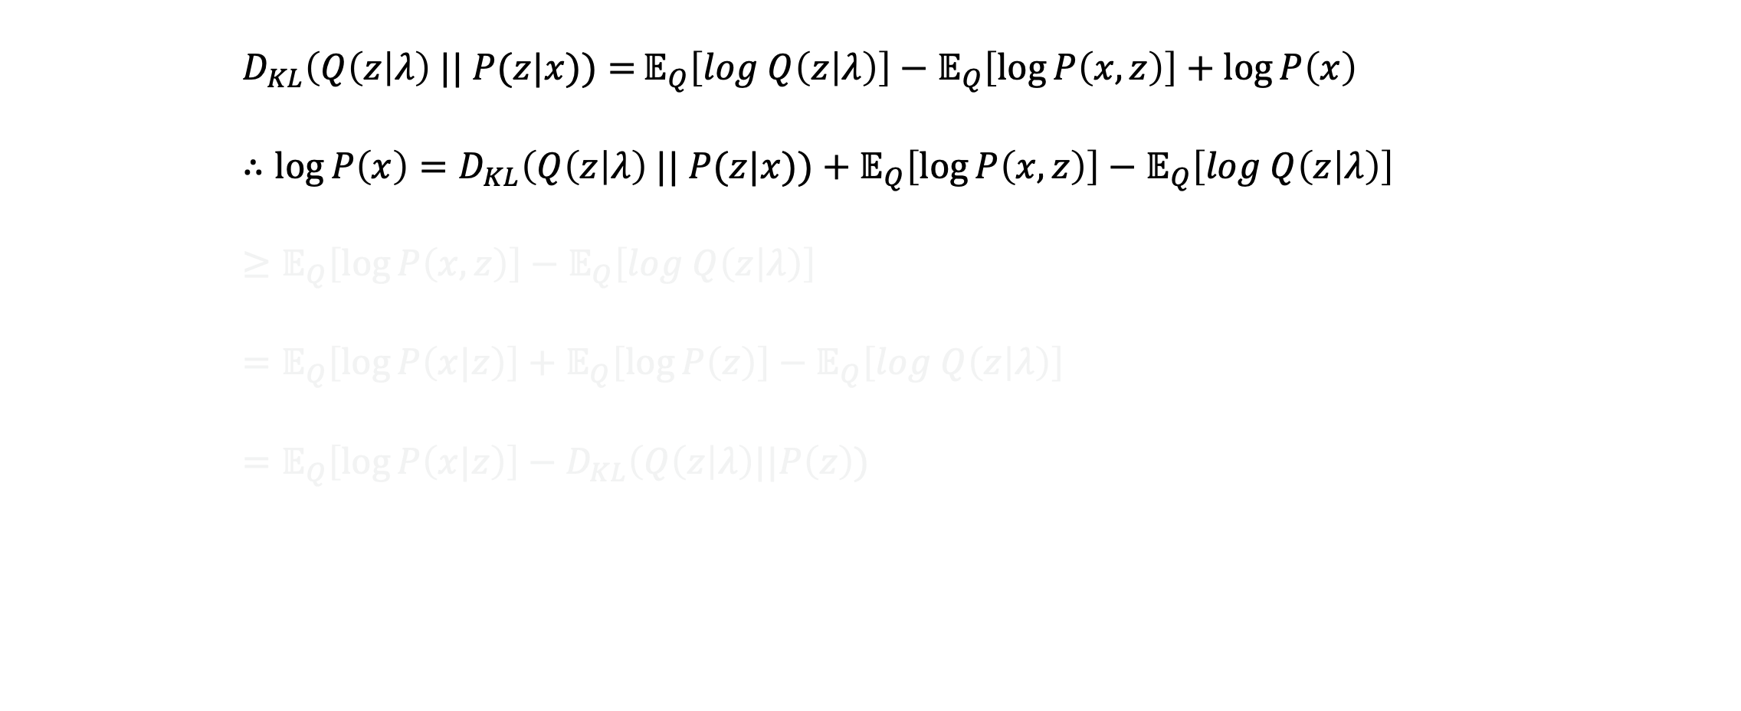
Variational Inference(VI)
Basics
        $$D_{KL}\left(Q\left(z\right|λ\right) || P(z|x))={𝔼_{Q}\left[log Q\left(z | λ\right)\right]−𝔼_{Q}\left[\log{P\left(x,z\right)}\right]+\log{P\left(x\right)} } \\ ∴\log{P\left(x\right)}=D_{KL}\left(Q\left(z\right|λ\right) || P(z|x))+𝔼_{Q}\left[\log{P\left(x,z\right)}\right]−𝔼_{Q}\left[log Q\left(z | λ\right)\right]≥𝔼_{Q}\left[\log{P\left(x,z\right)}\right]−𝔼_{Q}\left[log Q\left(z | λ\right)\right] \\ =𝔼_{Q}\left[\log{P\left(x|z\right)}\right]+𝔼_{Q}\left[\log{P\left(z\right)}\right]−𝔼_{Q}\left[log Q\left(z | λ\right)\right] \\ =𝔼_{Q}\left[\log{P\left(x|z\right)}\right]−D_{KL}\left(Q\left(z\right|λ\right)||P\left(z\right))$$

Slide 60

Variational Inference(VI)
Basics
        $$D_{KL}\left(Q\left(z\right|λ\right) || P(z|x))={𝔼_{Q}\left[log Q\left(z | λ\right)\right]−𝔼_{Q}\left[\log{P\left(x,z\right)}\right]+\log{P\left(x\right)} } \\ ∴\log{P\left(x\right)}=D_{KL}\left(Q\left(z\right|λ\right) || P(z|x))+𝔼_{Q}\left[\log{P\left(x,z\right)}\right]−𝔼_{Q}\left[log Q\left(z | λ\right)\right]≥𝔼_{Q}\left[\log{P\left(x,z\right)}\right]−𝔼_{Q}\left[log Q\left(z | λ\right)\right] \\ =𝔼_{Q}\left[\log{P\left(x|z\right)}\right]+𝔼_{Q}\left[\log{P\left(z\right)}\right]−𝔼_{Q}\left[log Q\left(z | λ\right)\right] \\ =𝔼_{Q}\left[\log{P\left(x|z\right)}\right]−D_{KL}\left(Q\left(z\right|λ\right)||P\left(z\right))$$
$$≥0$$

Slide 61
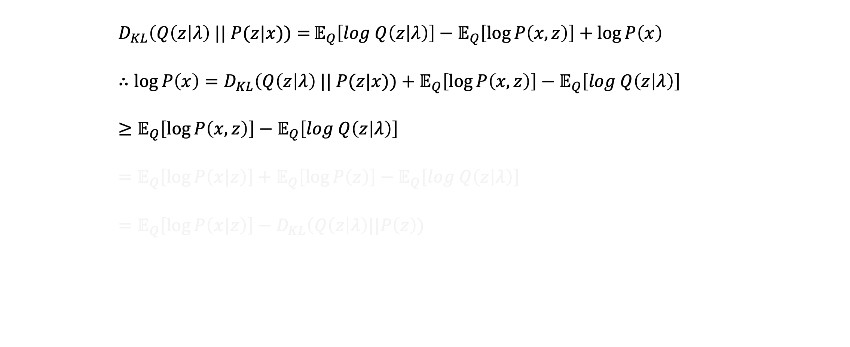
Variational Inference(VI)
Basics
        $$D_{KL}\left(Q\left(z\right|λ\right) || P(z|x))={𝔼_{Q}\left[log Q\left(z | λ\right)\right]−𝔼_{Q}\left[\log{P\left(x,z\right)}\right]+\log{P\left(x\right)} } \\ ∴\log{P\left(x\right)}=D_{KL}\left(Q\left(z\right|λ\right) || P(z|x))+𝔼_{Q}\left[\log{P\left(x,z\right)}\right]−𝔼_{Q}\left[log Q\left(z | λ\right)\right]≥𝔼_{Q}\left[\log{P\left(x,z\right)}\right]−𝔼_{Q}\left[log Q\left(z | λ\right)\right] \\ =𝔼_{Q}\left[\log{P\left(x|z\right)}\right]+𝔼_{Q}\left[\log{P\left(z\right)}\right]−𝔼_{Q}\left[log Q\left(z | λ\right)\right] \\ =𝔼_{Q}\left[\log{P\left(x|z\right)}\right]−D_{KL}\left(Q\left(z\right|λ\right)||P\left(z\right))$$
ELBO

Slide 62

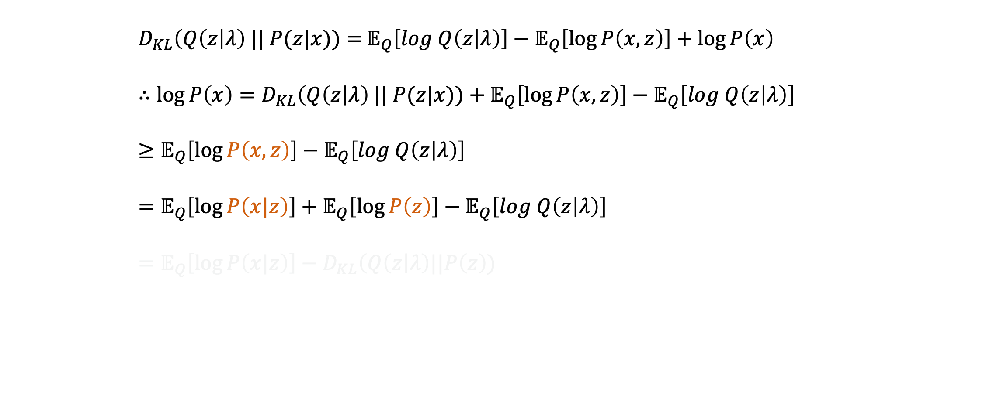
Variational Inference(VI)
Basics
        $$D_{KL}\left(Q\left(z\right|λ\right) || P(z|x))={𝔼_{Q}\left[log Q\left(z | λ\right)\right]−𝔼_{Q}\left[\log{P\left(x,z\right)}\right]+\log{P\left(x\right)} } \\ ∴\log{P\left(x\right)}=D_{KL}\left(Q\left(z\right|λ\right) || P(z|x))+𝔼_{Q}\left[\log{P\left(x,z\right)}\right]−𝔼_{Q}\left[log Q\left(z | λ\right)\right]≥𝔼_{Q}\left[\log{P\left(x,z\right)}\right]−𝔼_{Q}\left[log Q\left(z | λ\right)\right] \\ =𝔼_{Q}\left[\log{P\left(x|z\right)}\right]+𝔼_{Q}\left[\log{P\left(z\right)}\right]−𝔼_{Q}\left[log Q\left(z | λ\right)\right] \\ =𝔼_{Q}\left[\log{P\left(x|z\right)}\right]−D_{KL}\left(Q\left(z\right|λ\right)||P\left(z\right))$$
$⋯$(By Bayesian)

Slide 63
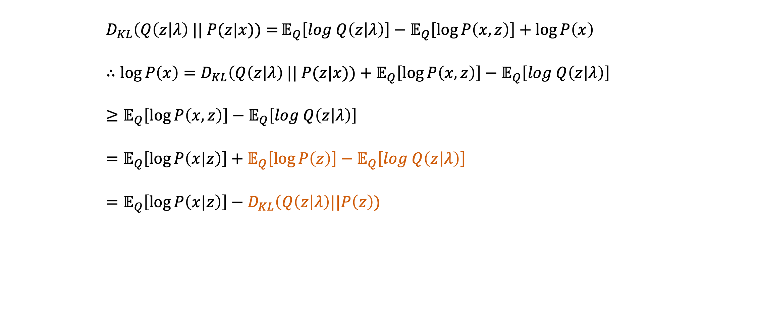

Variational Inference(VI)
Basics
        $$D_{KL}\left(Q\left(z\right|λ\right) || P(z|x))={𝔼_{Q}\left[log Q\left(z | λ\right)\right]−𝔼_{Q}\left[\log{P\left(x,z\right)}\right]+\log{P\left(x\right)} } \\ ∴\log{P\left(x\right)}=D_{KL}\left(Q\left(z\right|λ\right) || P(z|x))+𝔼_{Q}\left[\log{P\left(x,z\right)}\right]−𝔼_{Q}\left[log Q\left(z | λ\right)\right]≥𝔼_{Q}\left[\log{P\left(x,z\right)}\right]−𝔼_{Q}\left[log Q\left(z | λ\right)\right] \\ =𝔼_{Q}\left[\log{P\left(x|z\right)}\right]+𝔼_{Q}\left[\log{P\left(z\right)}\right]−𝔼_{Q}\left[log Q\left(z | λ\right)\right] \\ =𝔼_{Q}\left[\log{P\left(x|z\right)}\right]−D_{KL}\left(Q\left(z\right|λ\right)||P\left(z\right))$$
$⋯$(By Bayesian)
$⋯$(By definition)

Slide 64
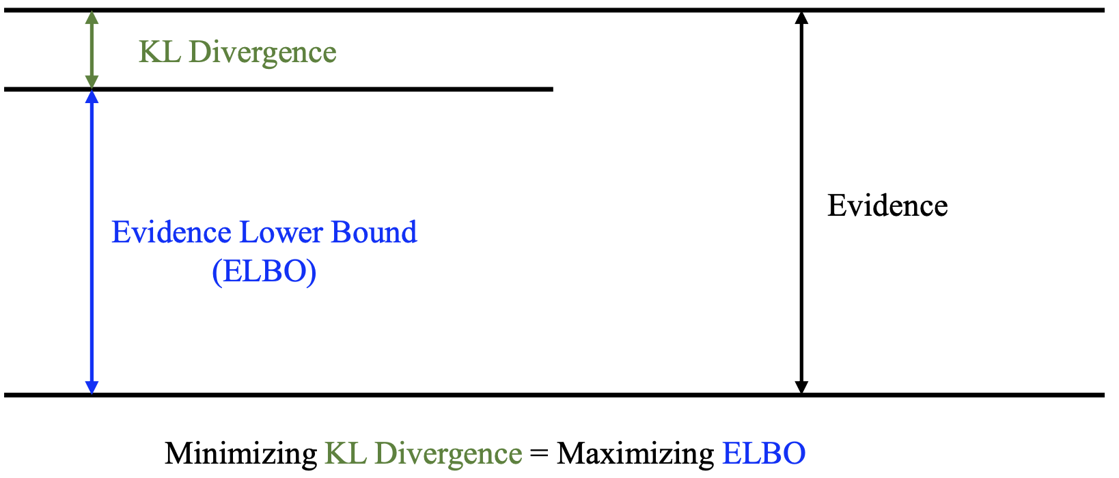
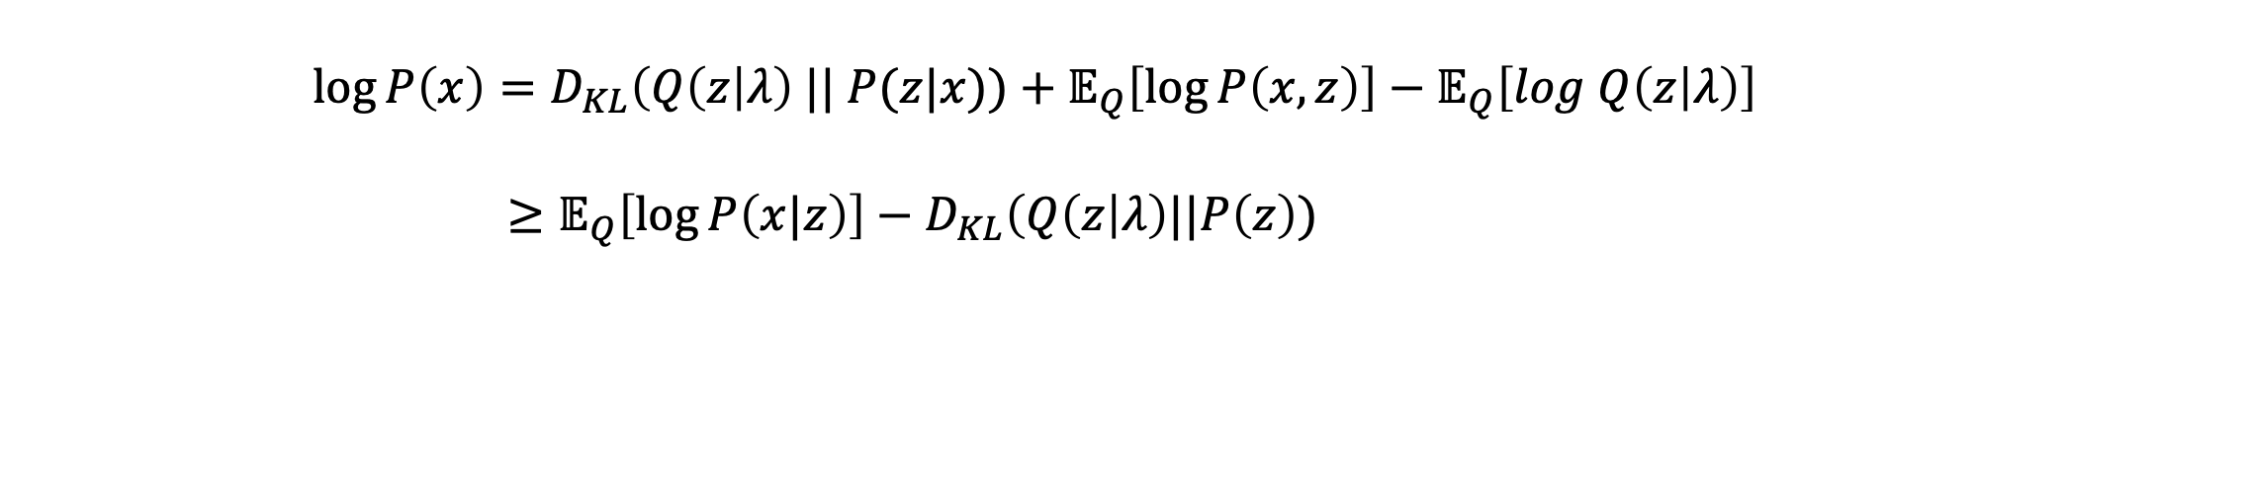
Variational Inference(VI)
Basics
        $\log{P\left(x\right)}=D_{KL}\left(Q\left(z\right|λ\right) || P(z|x))+𝔼_{Q}\left[\log{P\left(x,z\right)}\right]−𝔼_{Q}\left[log Q\left(z | λ\right)\right]$
        $≥𝔼_{Q}\left[\log{P\left(x|z\right)}\right]−D_{KL}\left(Q\left(z\right|λ\right)||P\left(z\right))$

Slide 65
Variational Inference(VI)
Basics
        $\log{P\left(x\right)}=D_{KL}\left(Q\left(z\right|λ\right) || P(z|x))+𝔼_{Q}\left[\log{P\left(x,z\right)}\right]−𝔼_{Q}\left[log Q\left(z | λ\right)\right]$
        $≥𝔼_{Q}\left[\log{P\left(x|z\right)}\right]−D_{KL}\left(Q\left(z\right|λ\right)||P\left(z\right))$
Resource:
IWAE
Normalizing flow

Slide 66
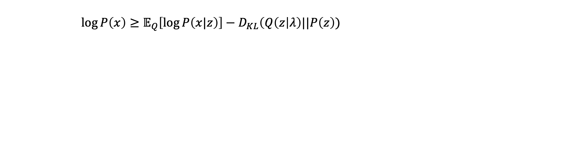
Amortized Variational Inference(AVI)
Basics
        $\log{P\left(x\right)}≥𝔼_{Q}\left[\log{P\left(x|z\right)}\right]−D_{KL}\left(Q\left(z\right|λ\right)||P\left(z\right))$

Slide 67
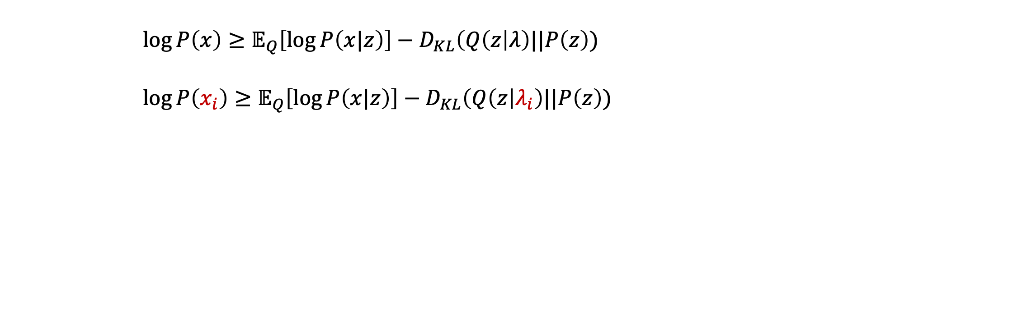
Amortized Variational Inference(AVI)
Basics
        $\log{P\left(x\right)}≥𝔼_{Q}\left[\log{P\left(x|z\right)}\right]−D_{KL}\left(Q\left(z\right|λ\right)||P\left(z\right))$
        $\log{P\left(x_{i}\right)}≥𝔼_{Q}\left[\log{P\left(x|z\right)}\right]−D_{KL}\left(Q\left(z\right|λ_{i}\right)||P\left(z\right))$

Slide 68

Amortized Variational Inference(AVI)
Basics
        $\log{P\left(x\right)}≥𝔼_{Q}\left[\log{P\left(x|z\right)}\right]−D_{KL}\left(Q\left(z\right|λ\right)||P\left(z\right))$
        $\log{P\left(x_{i}\right)}≥𝔼_{Q}\left[\log{P\left(x|z\right)}\right]−D_{KL}\left(Q\left(z\right|λ_{i}\right)||P\left(z\right))$
We have to optimize each $λ_{i}$ given every $x_{i}$

Slide 69

Amortized Variational Inference(AVI)
Basics
        $\log{P\left(x\right)}≥𝔼_{Q}\left[\log{P\left(x|z\right)}\right]−D_{KL}\left(Q\left(z\right|λ\right)||P\left(z\right))$
        $\log{P\left(x_{i}\right)}≥𝔼_{Q}\left[\log{P\left(x|z\right)}\right]−D_{KL}\left(Q\left(z\right|λ_{i}\right)||P\left(z\right))$
We have to optimize each $λ_{i}$ given every $x_{i}$
Let’s model $φ$ that satisfies $f_{φ}\left(x\right)=λ_{i}$

Slide 70
Deep dive into VAE

Slide 71
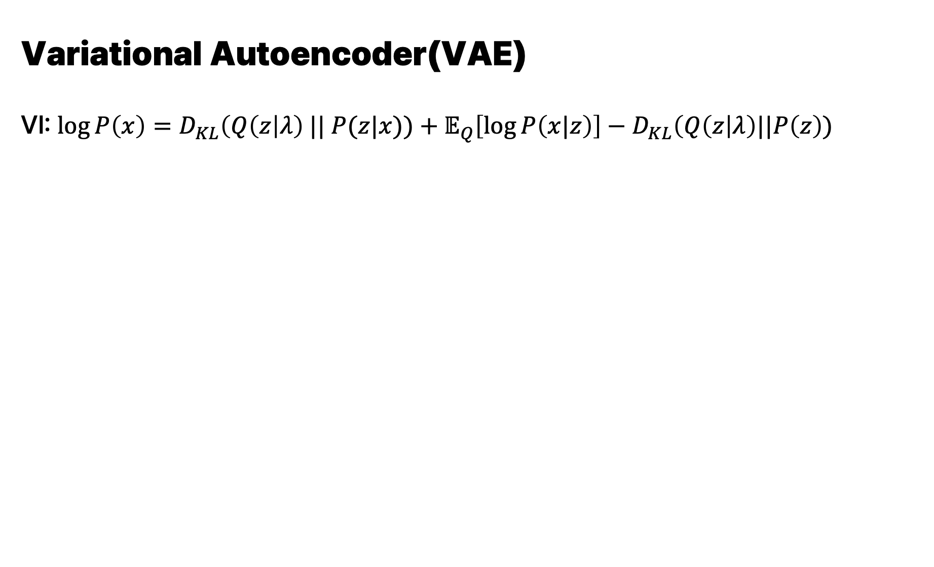
        Variational Autoencoder(VAE)
        VI: $\log{P\left(x\right)}=D_{KL}\left(Q\left(z\right|λ\right) || P(z|x))+𝔼_{Q}\left[\log{P\left(x|z\right)}\right]−D_{KL}\left(Q\left(z\right|λ\right)||P\left(z\right))$
Deep dive into VAE

Slide 72
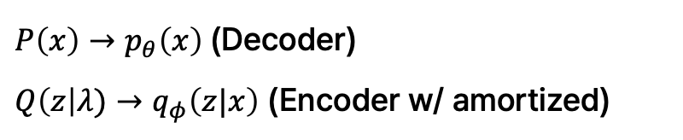
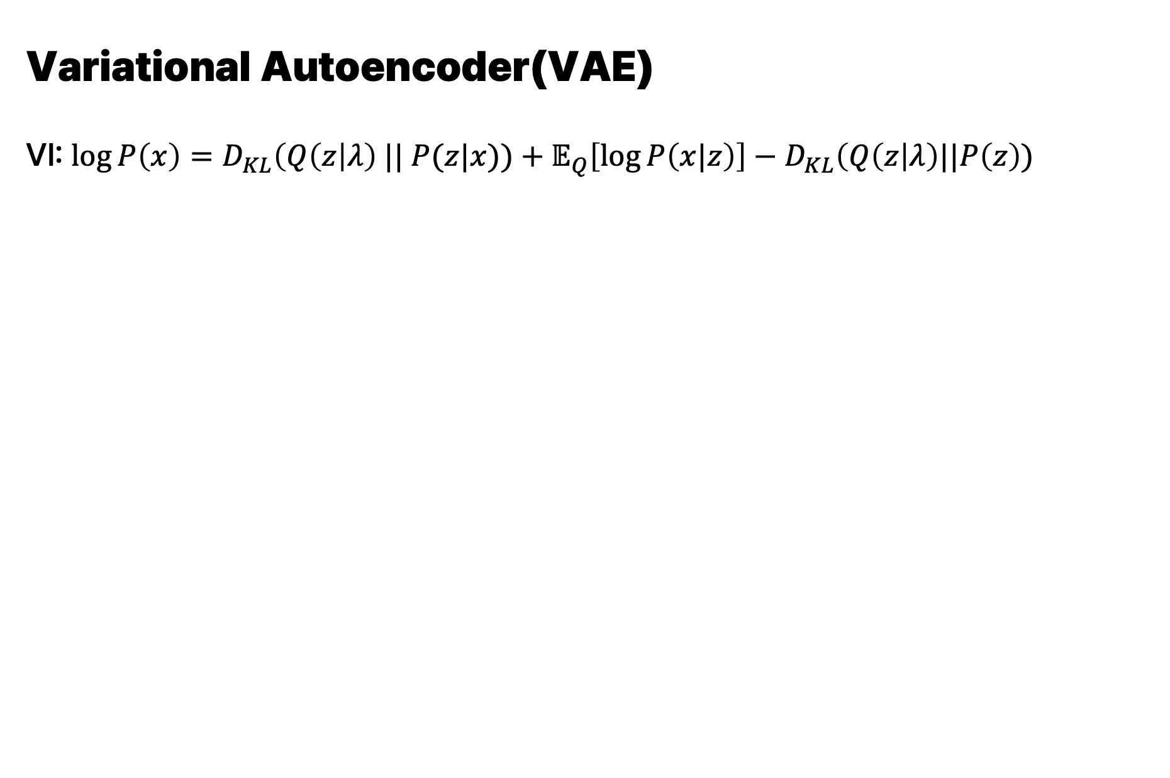
        Variational Autoencoder(VAE)
        VI: $\log{P\left(x\right)}=D_{KL}\left(Q\left(z\right|λ\right) || P(z|x))+𝔼_{Q}\left[\log{P\left(x|z\right)}\right]−D_{KL}\left(Q\left(z\right|λ\right)||P\left(z\right))$
Deep dive into VAE
$P\left(x\right)→p_{θ}\left(x\right)$ (Decoder)
$Q\left(z\right|λ)→q_{φ}\left(z|x\right)$ (Encoder w/ amortized)

Slide 73
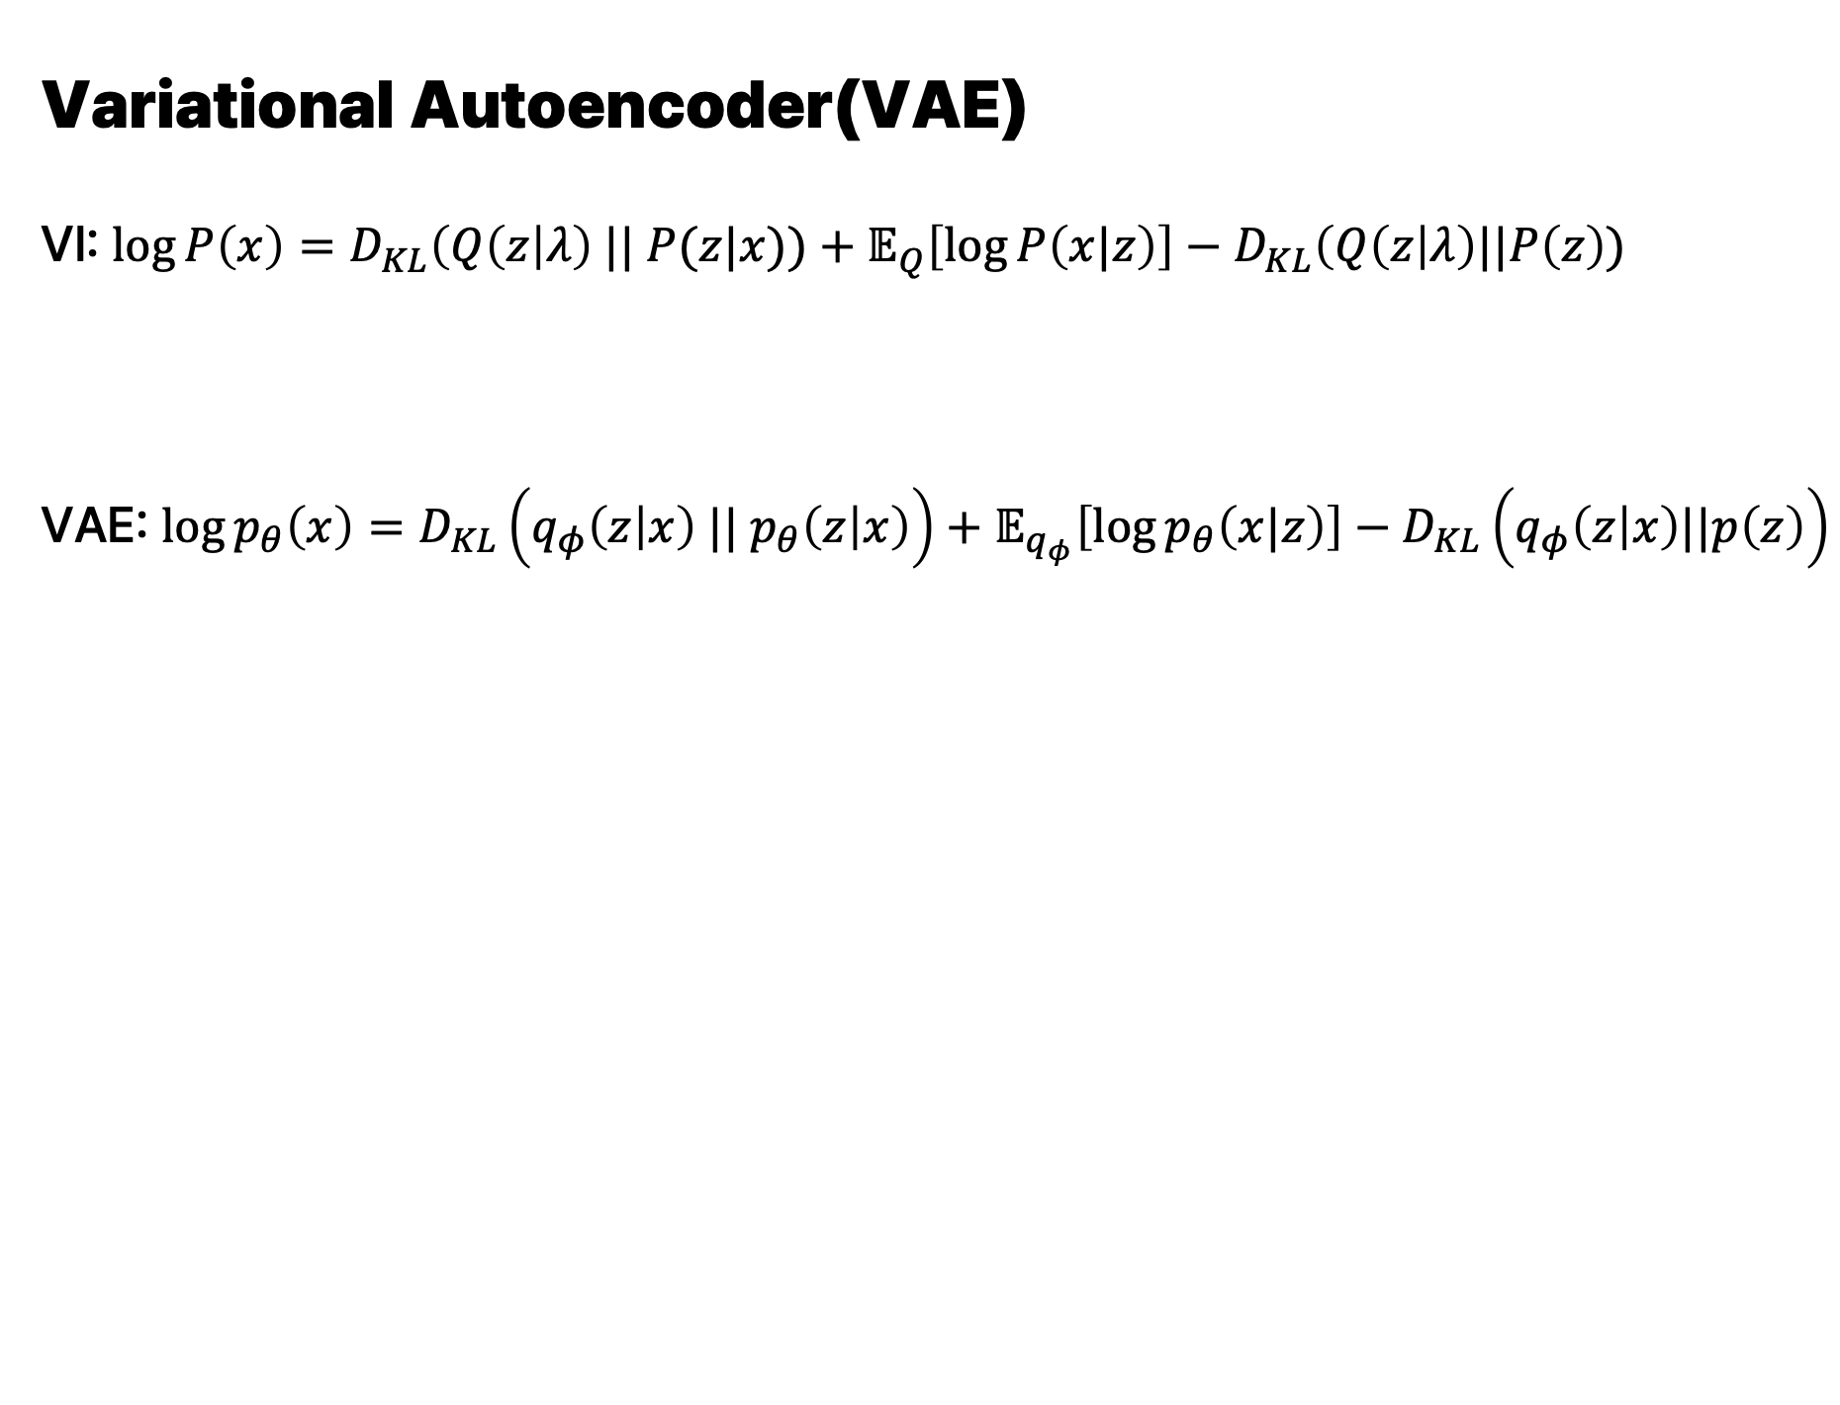
        Variational Autoencoder(VAE)
        VI: $\log{P\left(x\right)}=D_{KL}\left(Q\left(z\right|λ\right) || P(z|x))+𝔼_{Q}\left[\log{P\left(x|z\right)}\right]−D_{KL}\left(Q\left(z\right|λ\right)||P\left(z\right))$
        VAE: $\log{p_{θ}\left(x\right)}=D_{KL}\left(q_{φ}\left(z | x\right) || p_{θ}\left(z | x\right)\right)+𝔼_{q_{φ}}\left[\log{p_{θ}\left(x|z\right)}\right]−D_{KL}\left(q_{φ}\left(z | x\right)||p\left(z\right)\right)$
Deep dive into VAE
$P\left(x\right)→p_{θ}\left(x\right)$ (Decoder)
$Q\left(z\right|λ)→q_{φ}\left(z|x\right)$ (Encoder w/ amortized)

Slide 74
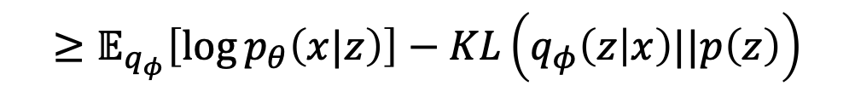
        Variational Autoencoder(VAE)
        VI: $\log{P\left(x\right)}=D_{KL}\left(Q\left(z\right|λ\right) || P(z|x))+𝔼_{Q}\left[\log{P\left(x|z\right)}\right]−D_{KL}\left(Q\left(z\right|λ\right)||P\left(z\right))$
        VAE: $\log{p_{θ}\left(x\right)}=D_{KL}\left(q_{φ}\left(z | x\right) || p_{θ}\left(z | x\right)\right)+𝔼_{q_{φ}}\left[\log{p_{θ}\left(x|z\right)}\right]−D_{KL}\left(q_{φ}\left(z | x\right)||p\left(z\right)\right)$
Deep dive into VAE
$P\left(x\right)→p_{θ}\left(x\right)$ (Decoder)
$Q\left(z\right|λ)→q_{φ}\left(z|x\right)$ (Encoder w/ amortized)
$$≥𝔼_{q_{φ}}\left[\log{p_{θ}\left(x|z\right)}\right]−KL\left(q_{φ}\left(z | x\right)||p\left(z\right)\right)$$

Slide 75
        Variational Autoencoder(VAE)
        VI: $\log{P\left(x\right)}=D_{KL}\left(Q\left(z\right|λ\right) || P(z|x))+𝔼_{Q}\left[\log{P\left(x|z\right)}\right]−D_{KL}\left(Q\left(z\right|λ\right)||P\left(z\right))$
        VAE: $\log{p_{θ}\left(x\right)}=D_{KL}\left(q_{φ}\left(z | x\right) || p_{θ}\left(z | x\right)\right)+𝔼_{q_{φ}}\left[\log{p_{θ}\left(x|z\right)}\right]−D_{KL}\left(q_{φ}\left(z | x\right)||p\left(z\right)\right)$
Deep dive into VAE
$P\left(x\right)→p_{θ}\left(x\right)$ (Decoder)
$Q\left(z\right|λ)→q_{φ}\left(z|x\right)$ (Encoder w/ amortized)
$$≥𝔼_{q_{φ}}\left[\log{p_{θ}\left(x|z\right)}\right]−KL\left(q_{φ}\left(z | x\right)||p\left(z\right)\right)$$
How can we maximize it?

Slide 76
VAE Optimization
Deep dive into VAE
Probabilistic
Encoder
$$q_{φ}(z|x)$$
$$Σ_{z|x}$$
Probabilistic
Decoder
$$p_{θ}\left(\hat{x}|z\right)$$
$$z$$
$$μ_{z|x}$$
Image $x$
Reconstructed image $\hat{x}$

Slide 77
VAE Optimization
Deep dive into VAE
Assumption1: $q_{φ}(z|x)$ follows multivariative Gaussian distribution
Probabilistic
Encoder
$$q_{φ}(z|x)$$
$$Σ_{z|x}$$
Probabilistic
Decoder
$$p_{θ}\left(\hat{x}|z\right)$$
$$z$$
$$μ_{z|x}$$
Image $x$
Reconstructed image $\hat{x}$

Slide 78
VAE Optimization
Deep dive into VAE
Assumption1: $q_{φ}(z|x)$ follows multivariative Gaussian distribution
Probabilistic
Encoder
$$q_{φ}(z|x)$$
$$Σ_{z|x}$$
Probabilistic
Decoder
$$p_{θ}\left(\hat{x}|z\right)$$
$$z$$
$$μ_{z|x}$$
Image $x$
Reconstructed image $\hat{x}$
Assumption2: $p\left(z\right)$ follows multivariative normal Gaussian distribution

Slide 79
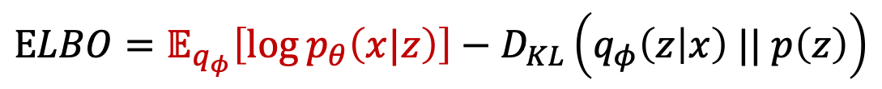
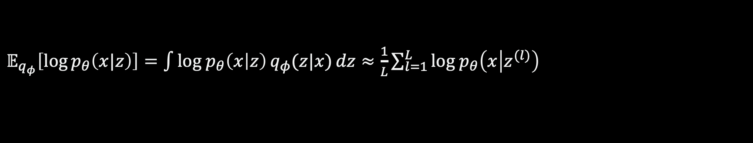

VAE Optimization – Reconstruction Term
Deep dive into VAE
$$ELBO=𝔼_{q_{φ}}\left[\log{p_{θ}\left(x|z\right)}\right]−D_{KL}\left(q_{φ}\left(z | x\right) || p\left(z\right)\right)$$
$𝔼_{q_{φ}}\left[\log{p_{θ}\left(x|z\right)}\right]=\int{log{ p}_{θ}\left(x | z\right)}{q_{φ}(z|x)}dz≈\frac{1}{L}\sum_{l=1}^{L}{log{ p}_{θ}\left(x | z^{(l)}\right)}$
$⋯$(By Monte-Carlo tech.)

Slide 80
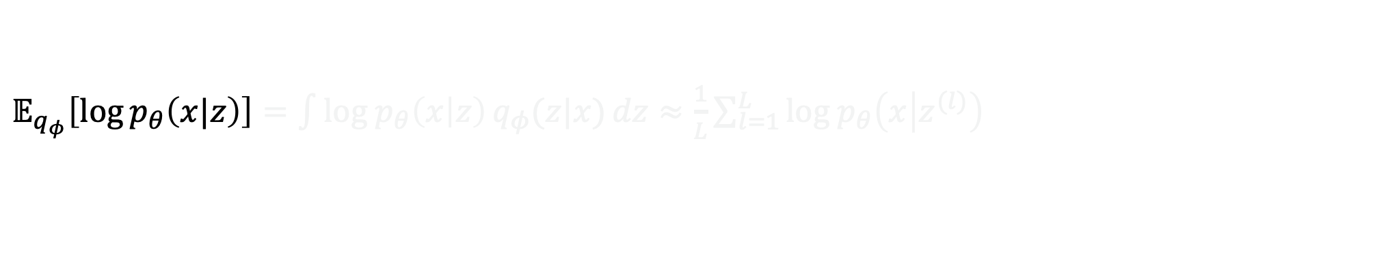
VAE Optimization – Reconstruction Term
Deep dive into VAE
$$ELBO=𝔼_{q_{φ}}\left[\log{p_{θ}\left(x|z\right)}\right]−D_{KL}\left(q_{φ}\left(z | x\right) || p\left(z\right)\right)$$
$𝔼_{q_{φ}}\left[\log{p_{θ}\left(x|z\right)}\right]=\int{log{ p}_{θ}\left(x | z\right)}{q_{φ}(z|x)}dz≈\frac{1}{L}\sum_{l=1}^{L}{log{ p}_{θ}\left(x | z^{(l)}\right)}$
$⋯$(By Monte-Carlo tech.)

Slide 81
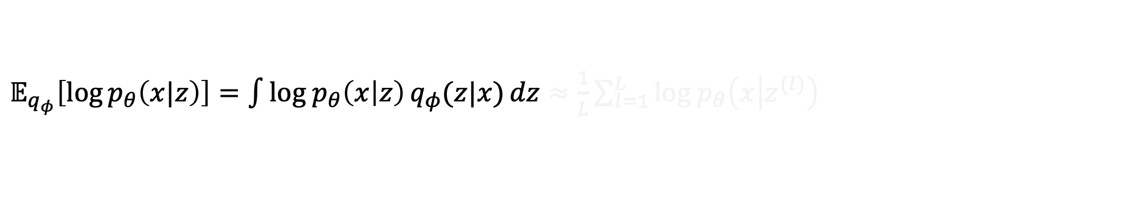
VAE Optimization – Reconstruction Term
Deep dive into VAE
$$ELBO=𝔼_{q_{φ}}\left[\log{p_{θ}\left(x|z\right)}\right]−D_{KL}\left(q_{φ}\left(z | x\right) || p\left(z\right)\right)$$
$𝔼_{q_{φ}}\left[\log{p_{θ}\left(x|z\right)}\right]=\int{log{ p}_{θ}\left(x | z\right)}{q_{φ}(z|x)}dz≈\frac{1}{L}\sum_{l=1}^{L}{log{ p}_{θ}\left(x | z^{(l)}\right)}$
$⋯$(By Monte-Carlo tech.)

Slide 82
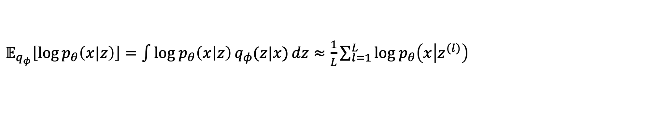

VAE Optimization – Reconstruction Term
Deep dive into VAE
$$ELBO=𝔼_{q_{φ}}\left[\log{p_{θ}\left(x|z\right)}\right]−D_{KL}\left(q_{φ}\left(z | x\right) || p\left(z\right)\right)$$
$𝔼_{q_{φ}}\left[\log{p_{θ}\left(x|z\right)}\right]=\int{log{ p}_{θ}\left(x | z\right)}{q_{φ}(z|x)}dz≈\frac{1}{L}\sum_{l=1}^{L}{log{ p}_{θ}\left(x | z^{(l)}\right)}$
$⋯$(By Monte-Carlo tech.)

Slide 83
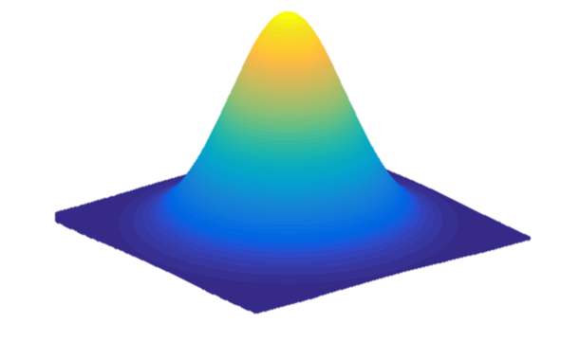
VAE Optimization – Reconstruction Term
Deep dive into VAE
$$ELBO=𝔼_{q_{φ}}\left[\log{p_{θ}\left(x|z\right)}\right]−D_{KL}\left(q_{φ}\left(z | x\right) || p\left(z\right)\right)$$
$𝔼_{q_{φ}}\left[\log{p_{θ}\left(x|z\right)}\right]=\int{log{ p}_{θ}\left(x | z\right)}{q_{φ}(z|x)}dz≈\frac{1}{L}\sum_{l=1}^{L}{log{ p}_{θ}\left(x | z^{(l)}\right)}$
$⋯$(By Monte-Carlo tech.)
[Monte-Carlo Tecnique(Estimation)]
$$𝒩(μ_{φ},σ_{φ}^{2}I)$$

Slide 84




VAE Optimization – Reconstruction Term
Deep dive into VAE
$$ELBO=𝔼_{q_{φ}}\left[\log{p_{θ}\left(x|z\right)}\right]−D_{KL}\left(q_{φ}\left(z | x\right) || p\left(z\right)\right)$$
$𝔼_{q_{φ}}\left[\log{p_{θ}\left(x|z\right)}\right]=\int{log{ p}_{θ}\left(x | z\right)}{q_{φ}(z|x)}dz≈\frac{1}{L}\sum_{l=1}^{L}{log{ p}_{θ}\left(x | z^{(l)}\right)}$
$⋯$(By Monte-Carlo tech.)
[Monte-Carlo Tecnique(Estimation)]
$$log{ p}_{θ}\left(x | z^{1}\right)$$
$$z^{1}$$
$$log{ p}_{θ}\left(x | z^{2}\right)$$
$$z^{2}$$
$$⋮$$
$$⋮$$
$$log{ p}_{θ}\left(x | z^{n}\right)$$
$$z^{n}$$
$$⋮$$
$$⋮$$
$$log{ p}_{θ}\left(x | z^{L}\right)$$
$$z^{L}$$
$$𝒩(μ_{φ},σ_{φ}^{2}I)$$

Slide 85
VAE Optimization – Reconstruction Term
Deep dive into VAE
$$ELBO=𝔼_{q_{φ}}\left[\log{p_{θ}\left(x|z\right)}\right]−D_{KL}\left(q_{φ}\left(z | x\right) || p\left(z\right)\right)$$
$𝔼_{q_{φ}}\left[\log{p_{θ}\left(x|z\right)}\right]=\int{log{ p}_{θ}\left(x | z\right)}{q_{φ}(z|x)}dz≈\frac{1}{L}\sum_{l=1}^{L}{log{ p}_{θ}\left(x | z^{(l)}\right)}$
$⋯$(By Monte-Carlo tech.)
[Monte-Carlo Tecnique(Estimation)]
$$log{ p}_{θ}\left(x | z^{1}\right)$$
$$z^{1}$$
$$log{ p}_{θ}\left(x | z^{2}\right)$$
$$z^{2}$$
$$⋮$$
$$⋮$$
$$⋮$$
Mean
$$log{ p}_{θ}\left(x | z^{n}\right)$$
$$z^{n}$$
$$⋮$$
$$⋮$$
$$⋮$$
$$log{ p}_{θ}\left(x | z^{L}\right)$$
$$z^{L}$$
$$𝒩(μ_{φ},σ_{φ}^{2}I)$$

Slide 86
VAE Optimization – Reconstruction Term
Deep dive into VAE
$$ELBO=𝔼_{q_{φ}}\left[\log{p_{θ}\left(x|z\right)}\right]−D_{KL}\left(q_{φ}\left(z | x\right) || p\left(z\right)\right)$$
$𝔼_{q_{φ}}\left[\log{p_{θ}\left(x|z\right)}\right]=\int{log{ p}_{θ}\left(x | z\right)}{q_{φ}(z|x)}dz≈\frac{1}{L}\sum_{l=1}^{L}{log{ p}_{θ}\left(x | z^{(l)}\right)}$
$⋯$(By Monte-Carlo tech.)
[Monte-Carlo Tecnique(Estimation)]
$$log{ p}_{θ}\left(x | z^{1}\right)$$
$$z^{1}$$
$$log{ p}_{θ}\left(x | z^{2}\right)$$
$$z^{2}$$
$$⋮$$
$$⋮$$
$$⋮$$
Mean
$$𝔼_{q_{φ}}\left[\log{p_{θ}\left(x|z\right)}\right]$$
$$log{ p}_{θ}\left(x | z^{n}\right)$$
$$z^{n}$$
$$⋮$$
$$⋮$$
$$⋮$$
$$log{ p}_{θ}\left(x | z^{L}\right)$$
$$z^{L}$$
$$𝒩(μ_{φ},σ_{φ}^{2}I)$$

Slide 87

VAE Optimization – Reconstruction Term
Deep dive into VAE
$$ELBO=𝔼_{q_{φ}}\left[\log{p_{θ}\left(x|z\right)}\right]−D_{KL}\left(q_{φ}\left(z | x\right) || p\left(z\right)\right)$$
$𝔼_{q_{φ}}\left[\log{p_{θ}\left(x|z\right)}\right]=\int{log{ p}_{θ}\left(x | z\right)}{q_{φ}(z|x)}dz≈\frac{1}{L}\sum_{l=1}^{L}{log{ p}_{θ}\left(x | z^{(l)}\right)}$
(case1) $p_{θ}\left(x | z\right)$: Gaussian
$p_{θ}\left(x | z\right) \sim 𝒩\left(x;μ, σ^{2}I\right)$
$log{ p}_{θ}\left(x | z^{(l)}\right)=log 𝒩\left(x;μ_{θ}, σ_{θ}^{2}I\right)=log\left(\frac{1}{\sqrt{{\left(2πσ^{2}\right)}^{d}}}\exp\left(−\frac{{\left|\left|x−μ_{θ}\right|\right|}^{2}}{2σ^{2}}\right)\right)$
$=−\frac{1}{2σ^{2}}{\left|\left|x−μ_{θ}\right|\right|}^{2}−log\sqrt{{\left(2πσ^{2}\right)}^{d}}$
$⋯$(By Monte-Carlo tech.)

Slide 88

VAE Optimization – Reconstruction Term
Deep dive into VAE
$$ELBO=𝔼_{q_{φ}}\left[\log{p_{θ}\left(x|z\right)}\right]−D_{KL}\left(q_{φ}\left(z | x\right) || p\left(z\right)\right)$$
$𝔼_{q_{φ}}\left[\log{p_{θ}\left(x|z\right)}\right]=\int{log{ p}_{θ}\left(x | z\right)}{q_{φ}(z|x)}dz≈\frac{1}{L}\sum_{l=1}^{L}{log{ p}_{θ}\left(x | z^{(l)}\right)}$
(case1) $p_{θ}\left(x | z\right)$: Gaussian
$p_{θ}\left(x | z\right) \sim 𝒩\left(μ_{θ}, σ_{θ}^{2}I\right)$
$log{ p}_{θ}\left(x | z^{(l)}\right)=log 𝒩\left(x;μ_{θ}, σ_{θ}^{2}I\right)=log\left(\frac{1}{\sqrt{{\left(2πσ_{θ}^{2}\right)}^{d}}}\exp\left(−\frac{{\left|\left|x−μ_{θ}\right|\right|}^{2}}{2σ_{θ}^{2}}\right)\right)$
$=−\frac{1}{2σ^{2}}{\left|\left|x−μ_{θ}\right|\right|}^{2}−log\sqrt{{\left(2πσ_{θ}^{2}\right)}^{d}} \sqrt{{\left(2πσ_{θ}^{2}\right)}^{d}}$
$⋯$(By Monte-Carlo tech.)

Slide 89

VAE Optimization – Reconstruction Term
Deep dive into VAE
$$ELBO=𝔼_{q_{φ}}\left[\log{p_{θ}\left(x|z\right)}\right]−D_{KL}\left(q_{φ}\left(z | x\right) || p\left(z\right)\right)$$
$𝔼_{q_{φ}}\left[\log{p_{θ}\left(x|z\right)}\right]=\int{log{ p}_{θ}\left(x | z\right)}{q_{φ}(z|x)}dz≈\frac{1}{L}\sum_{l=1}^{L}{log{ p}_{θ}\left(x | z^{(l)}\right)}$
(case1) $p_{θ}\left(x | z\right)$: Gaussian
$p_{θ}\left(x | z\right) \sim 𝒩\left(μ_{θ}, σ_{θ}^{2}I\right)$
$log{ p}_{θ}\left(x | z^{(l)}\right)=log 𝒩\left(x;μ_{θ}, σ_{θ}^{2}I\right)=log\left(\frac{1}{\sqrt{{\left(2πσ_{θ}^{2}\right)}^{d}}}\exp\left(−\frac{{\left|\left|x−μ_{θ}\right|\right|}^{2}}{2σ_{θ}^{2}}\right)\right)$
$=−\frac{1}{2σ^{2}}{\left|\left|x−μ_{θ}\right|\right|}^{2}−log\sqrt{{\left(2πσ_{θ}^{2}\right)}^{d}} \sqrt{{\left(2πσ_{θ}^{2}\right)}^{d}}$
$⋯$(By Monte-Carlo tech.)

Slide 90

VAE Optimization – Reconstruction Term
Deep dive into VAE
$$ELBO=𝔼_{q_{φ}}\left[\log{p_{θ}\left(x|z\right)}\right]−D_{KL}\left(q_{φ}\left(z | x\right) || p\left(z\right)\right)$$
$𝔼_{q_{φ}}\left[\log{p_{θ}\left(x|z\right)}\right]=\int{log{ p}_{θ}\left(x | z\right)}{q_{φ}(z|x)}dz≈\frac{1}{L}\sum_{l=1}^{L}{log{ p}_{θ}\left(x | z^{(l)}\right)}$
(case1) $p_{θ}\left(x | z\right)$: Gaussian
$p_{θ}\left(x | z\right) \sim 𝒩\left(μ_{θ}, σ_{θ}^{2}I\right)$
$log{ p}_{θ}\left(x | z^{(l)}\right)=log 𝒩\left(x;μ_{θ}, σ_{θ}^{2}I\right)=log\left(\frac{1}{\sqrt{{\left(2πσ_{θ}^{2}\right)}^{d}}}\exp\left(−\frac{{\left|\left|x−μ_{θ}\right|\right|}^{2}}{2σ_{θ}^{2}}\right)\right)$
$=−\frac{1}{2σ^{2}}{\left|\left|x−μ_{θ}\right|\right|}^{2}−log\sqrt{{\left(2πσ_{θ}^{2}\right)}^{d}}$
$⋯$(By Monte-Carlo tech.)

Slide 91

VAE Optimization – Reconstruction Term
Deep dive into VAE
$$ELBO=𝔼_{q_{φ}}\left[\log{p_{θ}\left(x|z\right)}\right]−D_{KL}\left(q_{φ}\left(z | x\right) || p\left(z\right)\right)$$
$𝔼_{q_{φ}}\left[\log{p_{θ}\left(x|z\right)}\right]=\int{log{ p}_{θ}\left(x | z\right)}{q_{φ}(z|x)}dz≈\frac{1}{L}\sum_{l=1}^{L}{log{ p}_{θ}\left(x | z^{(l)}\right)}$
(case1) $p_{θ}\left(x | z\right)$: Gaussian
$p_{θ}\left(x | z\right) \sim 𝒩\left(μ_{θ}, σ_{θ}^{2}I\right)$
$log{ p}_{θ}\left(x | z^{(l)}\right)=log 𝒩\left(x;μ_{θ}, σ_{θ}^{2}I\right)=log\left(\frac{1}{\sqrt{{\left(2πσ_{θ}^{2}\right)}^{d}}}\exp\left(−\frac{{\left|\left|x−μ_{θ}\right|\right|}^{2}}{2σ_{θ}^{2}}\right)\right)$
$=−\frac{1}{2σ^{2}}{\left|\left|x−μ_{θ}\right|\right|}^{2}−log\sqrt{{\left(2πσ_{θ}^{2}\right)}^{d}}$
$⋯$(By Monte-Carlo tech.)

Slide 92
VAE Optimization – Reconstruction Term
Deep dive into VAE
$$ELBO=𝔼_{q_{φ}}\left[\log{p_{θ}\left(x|z\right)}\right]−D_{KL}\left(q_{φ}\left(z | x\right) || p\left(z\right)\right)$$
$𝔼_{q_{φ}}\left[\log{p_{θ}\left(x|z\right)}\right]=\int{log{ p}_{θ}\left(x | z\right)}{q_{φ}(z|x)}dz≈\frac{1}{L}\sum_{l=1}^{L}{log{ p}_{θ}\left(x | z^{(l)}\right)}$
(case1) $p_{θ}\left(x | z\right)$: Gaussian
$p_{θ}\left(x | z\right) \sim 𝒩\left(μ_{θ}, σ_{θ}^{2}I\right)$
$log{ p}_{θ}\left(x | z^{(l)}\right)=log 𝒩\left(x;μ_{θ}, σ_{θ}^{2}I\right)=log\left(\frac{1}{\sqrt{{\left(2πσ_{θ}^{2}\right)}^{d}}}\exp\left(−\frac{{\left|\left|x−μ_{θ}\right|\right|}^{2}}{2σ_{θ}^{2}}\right)\right)$
$=−\frac{1}{2σ^{2}}{\left|\left|x−μ_{θ}\right|\right|}^{2}−log\sqrt{{\left(2πσ_{θ}^{2}\right)}^{d}}$
$⋯$(By Monte-Carlo tech.)
Constant if identity covariance

Slide 93

VAE Optimization – Reconstruction Term
Deep dive into VAE
$$ELBO=𝔼_{q_{φ}}\left[\log{p_{θ}\left(x|z\right)}\right]−D_{KL}\left(q_{φ}\left(z | x\right) || p\left(z\right)\right)$$
$𝔼_{q_{φ}}\left[\log{p_{θ}\left(x|z\right)}\right]=\int{log{ p}_{θ}\left(x | z\right)}{q_{φ}(z|x)}dz≈\frac{1}{L}\sum_{l=1}^{L}{log{ p}_{θ}\left(x | z^{(l)}\right)}$
(case1) $p_{θ}\left(x | z\right)$: Gaussian
$p_{θ}\left(x | z\right) \sim 𝒩\left(μ_{θ}, σ_{θ}^{2}I\right)$
$log{ p}_{θ}\left(x | z^{(l)}\right)=log 𝒩\left(x;μ_{θ}, σ_{θ}^{2}I\right)=log\left(\frac{1}{\sqrt{{\left(2πσ_{θ}^{2}\right)}^{d}}}\exp\left(−\frac{{\left|\left|x−μ_{θ}\right|\right|}^{2}}{2σ_{θ}^{2}}\right)\right)$
$=−\frac{1}{2σ^{2}}{\left|\left|x−μ_{θ}\right|\right|}^{2}−log\sqrt{{\left(2πσ_{θ}^{2}\right)}^{d}}$
$⋯$(By Monte-Carlo tech.)
This is why we call it “Reconstruction” term

Slide 94

VAE Optimization – Reconstruction Term
Deep dive into VAE
$$ELBO=𝔼_{q_{φ}}\left[\log{p_{θ}\left(x|z\right)}\right]−D_{KL}\left(q_{φ}\left(z | x\right) || p\left(z\right)\right)$$
$𝔼_{q_{φ}}\left[\log{p_{θ}\left(x|z\right)}\right]=\int{log{ p}_{θ}\left(x | z\right)}{q_{φ}(z|x)}dz≈\frac{1}{L}\sum_{l=1}^{L}{log{ p}_{θ}\left(x | z^{(l)}\right)}$
(case2) $p_{θ}\left(x | z\right)$: Bernoulli
$p_{θ}\left(x | z\right) \sim Benorlli\left(p_{i}\right)$
$log{ p}_{θ}\left(x | z^{(l)}\right)=log\prod_{j=1}^{D}{p_{θ}\left(x_{j} | z^{l}\right)=\sum_{j=1}^{D}{log}}p_{θ}\left(x_{j} | z^{l}\right)$
$=\sum_{j=1}^{D}{log}p_{i,j}^{x_{i,j}}{\left(1−p_{i,j}\right)}^{1−x_{i,j}}=$ $\sum_{j=1}^{D}{x_{i,j}log}p_{i,j}+\left(1−x_{i,j}\right)log(1−p_{i,j})$
$⋯$(By Monte-Carlo tech.)

Slide 95

VAE Optimization – Reconstruction Term
Deep dive into VAE
$$ELBO=𝔼_{q_{φ}}\left[\log{p_{θ}\left(x|z\right)}\right]−D_{KL}\left(q_{φ}\left(z | x\right) || p\left(z\right)\right)$$
$𝔼_{q_{φ}}\left[\log{p_{θ}\left(x|z\right)}\right]=\int{log{ p}_{θ}\left(x | z\right)}{q_{φ}(z|x)}dz≈\frac{1}{L}\sum_{l=1}^{L}{log{ p}_{θ}\left(x | z^{(l)}\right)}$
(case2) $p_{θ}\left(x | z\right)$: Bernoulli
$p_{θ}\left(x | z\right) \sim Benoulli\left(p\right)$
$log{ p}_{θ}\left(x | z^{(l)}\right)=log\prod_{j=1}^{D}{p_{θ}\left(x_{j} | z^{l}\right)=\sum_{j=1}^{D}{log}}p_{θ}\left(x_{j} | z^{l}\right)$
$=\sum_{j=1}^{D}{log}p_{i,j}^{x_{i,j}}{\left(1−p_{i,j}\right)}^{1−x_{i,j}}=$ $\sum_{j=1}^{D}{x_{i,j}log}p_{i,j}+\left(1−x_{i,j}\right)log(1−p_{i,j})$
$⋯$(By Monte-Carlo tech.)

Slide 96

VAE Optimization – Reconstruction Term
Deep dive into VAE
$$ELBO=𝔼_{q_{φ}}\left[\log{p_{θ}\left(x|z\right)}\right]−D_{KL}\left(q_{φ}\left(z | x\right) || p\left(z\right)\right)$$
$𝔼_{q_{φ}}\left[\log{p_{θ}\left(x|z\right)}\right]=\int{log{ p}_{θ}\left(x | z\right)}{q_{φ}(z|x)}dz≈\frac{1}{L}\sum_{l=1}^{L}{log{ p}_{θ}\left(x | z^{(l)}\right)}$
(case2) $p_{θ}\left(x | z\right)$: Bernoulli
$p_{θ}\left(x | z\right) \sim Benoulli\left(p\right)$
$log{ p}_{θ}\left(x | z^{(l)}\right)=log\prod_{j=1}^{D}{p_{θ}\left(x_{j} | z^{(l)}\right)=\sum_{j=1}^{D}{log}}p_{θ}\left(x_{j} | z^{l}\right)$
$=\sum_{j=1}^{D}{log}p_{i,j}^{x_{i,j}}{\left(1−p_{i,j}\right)}^{1−x_{i,j}}=$ $\sum_{j=1}^{D}{x_{i,j}log}p_{i,j}+\left(1−x_{i,j}\right)log(1−p_{i,j})$
$⋯$(By Monte-Carlo tech.)

Slide 97

VAE Optimization – Reconstruction Term
Deep dive into VAE
$$ELBO=𝔼_{q_{φ}}\left[\log{p_{θ}\left(x|z\right)}\right]−D_{KL}\left(q_{φ}\left(z | x\right) || p\left(z\right)\right)$$
$𝔼_{q_{φ}}\left[\log{p_{θ}\left(x|z\right)}\right]=\int{log{ p}_{θ}\left(x | z\right)}{q_{φ}(z|x)}dz≈\frac{1}{L}\sum_{l=1}^{L}{log{ p}_{θ}\left(x | z^{(l)}\right)}$
(case2) $p_{θ}\left(x | z\right)$: Bernoulli
$p_{θ}\left(x | z\right) \sim Benoulli\left(p\right)$
$log{ p}_{θ}\left(x | z^{(l)}\right)=log\prod_{j=1}^{D}{p_{θ}\left(x_{j} | z^{(l)}\right)=\sum_{j=1}^{D}{log}}p_{θ}\left(x_{j} | z^{(l)}\right)$
$=\sum_{j=1}^{D}{log}p_{i,j}^{x_{i,j}}{\left(1−p_{i,j}\right)}^{1−x_{i,j}}=$ $\sum_{j=1}^{D}{x_{i,j}log}p_{i,j}+\left(1−x_{i,j}\right)log(1−p_{i,j})$
$⋯$(By Monte-Carlo tech.)

Slide 98

VAE Optimization – Reconstruction Term
Deep dive into VAE
$$ELBO=𝔼_{q_{φ}}\left[\log{p_{θ}\left(x|z\right)}\right]−D_{KL}\left(q_{φ}\left(z | x\right) || p\left(z\right)\right)$$
$𝔼_{q_{φ}}\left[\log{p_{θ}\left(x|z\right)}\right]=\int{log{ p}_{θ}\left(x | z\right)}{q_{φ}(z|x)}dz≈\frac{1}{L}\sum_{l=1}^{L}{log{ p}_{θ}\left(x | z^{(l)}\right)}$
(case2) $p_{θ}\left(x | z\right)$: Bernoulli
$p_{θ}\left(x | z\right) \sim Benoulli\left(p\right)$
$log{ p}_{θ}\left(x | z^{(l)}\right)=log\prod_{j=1}^{D}{p_{θ}\left(x_{j} | z^{(l)}\right)=\sum_{j=1}^{D}{log}}p_{θ}\left(x_{j} | z^{(l)}\right)$
$=\sum_{j=1}^{D}{log}p_{j}^{x_{j}}{\left(1−p_{j}\right)}^{1−x_{j}}$ $\sum_{j=1}^{D}{x_{i,j}log}p_{i,j}+\left(1−x_{i,j}\right)log(1−p_{i,j})$
$⋯$(By Monte-Carlo tech.)

Slide 99

VAE Optimization – Reconstruction Term
Deep dive into VAE
$$ELBO=𝔼_{q_{φ}}\left[\log{p_{θ}\left(x|z\right)}\right]−D_{KL}\left(q_{φ}\left(z | x\right) || p\left(z\right)\right)$$
$𝔼_{q_{φ}}\left[\log{p_{θ}\left(x|z\right)}\right]=\int{log{ p}_{θ}\left(x | z\right)}{q_{φ}(z|x)}dz≈\frac{1}{L}\sum_{l=1}^{L}{log{ p}_{θ}\left(x | z^{(l)}\right)}$
(case2) $p_{θ}\left(x | z\right)$: Bernoulli
$p_{θ}\left(x | z\right) \sim Benoulli\left(p\right)$
$log{ p}_{θ}\left(x | z^{(l)}\right)=log\prod_{j=1}^{D}{p_{θ}\left(x_{j} | z^{(l)}\right)=\sum_{j=1}^{D}{log}}p_{θ}\left(x_{j} | z^{(l)}\right)$
$=\sum_{j=1}^{D}{log}p_{j}^{x_{j}}{\left(1−p_{j}\right)}^{1−x_{j}}=$ $\sum_{j=1}^{D}{x_{j}log}p_{j}+\left(1−x_{j}\right)log(1−p_{j})$
$⋯$(By Monte-Carlo tech.)

Slide 100
VAE Optimization – Reconstruction Term
Deep dive into VAE
$$ELBO=𝔼_{q_{φ}}\left[\log{p_{θ}\left(x|z\right)}\right]−D_{KL}\left(q_{φ}\left(z | x\right) || p\left(z\right)\right)$$
$𝔼_{q_{φ}}\left[\log{p_{θ}\left(x|z\right)}\right]=\int{log{ p}_{θ}\left(x | z\right)}{q_{φ}(z|x)}dz≈\frac{1}{L}\sum_{l=1}^{L}{log{ p}_{θ}\left(x | z^{(l)}\right)}$
(case2) $p_{θ}\left(x | z\right)$: Bernoulli
$p_{θ}\left(x | z\right) \sim Benoulli\left(p\right)$
$log{ p}_{θ}\left(x | z^{(l)}\right)=log\prod_{j=1}^{D}{p_{θ}\left(x_{j} | z^{(l)}\right)=\sum_{j=1}^{D}{log}}p_{θ}\left(x_{j} | z^{(l)}\right)$
$=\sum_{j=1}^{D}{log}p_{j}^{x_{j}}{\left(1−p_{j}\right)}^{1−x_{j}}=$ $\sum_{j=1}^{D}{x_{j}log}p_{j}+\left(1−x_{j}\right)log(1−p_{j})$
$⋯$(By Monte-Carlo tech.)
-Cross Entorpy

Slide 101

VAE Optimization – Regularization Term
Deep dive into VAE
$$ELBO=𝔼_{q_{φ}}\left[\log{p_{θ}\left(x|z\right)}\right]−D_{KL}\left(q_{φ}\left(z | x\right) || p\left(z\right)\right)$$

Slide 102

VAE Optimization – Regularization Term
Deep dive into VAE
$$ELBO=𝔼_{q_{φ}}\left[\log{p_{θ}\left(x|z\right)}\right]−D_{KL}\left(q_{φ}\left(z | x\right) || p\left(z\right)\right)$$
KLD for multivariate gaussian distributions
$D_{KL}\left(𝒩_{1} || 𝒩_{2}\right)=\frac{1}{2}(tr(\sum_{1}^{−1}{\sum_{0}{)}}+{\left(μ_{1}−μ_{0}\right)}^{T}\sum_{1}^{−1}{\left(μ_{1}−μ_{0}\right)−k+\log{(\frac{det\sum_{1}{.}}{det\sum_{0}{.} })}})$

Slide 103

VAE Optimization – Regularization Term
Deep dive into VAE
$$ELBO=𝔼_{q_{φ}}\left[\log{p_{θ}\left(x|z\right)}\right]−D_{KL}\left(q_{φ}\left(z | x\right) || p\left(z\right)\right)$$
$D_{KL}\left(q_{φ}\left(z | x\right) || p\left(z\right)\right)=\frac{1}{2}\left(tr\left(σ_{φ}^{2}I\right)+μ_{φ}^{T}μ_{φ}−J+\log\left(\frac{1}{\prod_{j}{{σ_{φ}}_{j}^{2}} }\right)\right)$
$=\frac{1}{2}\left(\sum_{j}{{σ_{φ}}_{j}^{2}}+\sum_{j}{{μ_{φ}}_{j}^{2}}−J−\sum_{j}{{log σ_{φ}}_{j}^{2}}\right)$
$=\frac{1}{2}\sum_{j}{{(μ_{φ}}_{j}^{2}+{σ_{φ}}_{j}^{2}−\log{{σ_{φ}}_{j}^{2}}−1)}$
KLD for multivariate gaussian distributions
$D_{KL}\left(𝒩_{1} || 𝒩_{2}\right)=\frac{1}{2}(tr(\sum_{1}^{−1}{\sum_{0}{)}}+{\left(μ_{1}−μ_{0}\right)}^{T}\sum_{1}^{−1}{\left(μ_{1}−μ_{0}\right)−k+\log{(\frac{det\sum_{1}{.}}{det\sum_{0}{.} })}})$

Slide 104

VAE Optimization – Regularization Term
Deep dive into VAE
$$ELBO=𝔼_{q_{φ}}\left[\log{p_{θ}\left(x|z\right)}\right]−D_{KL}\left(q_{φ}\left(z | x\right) || p\left(z\right)\right)$$
$D_{KL}\left(q_{φ}\left(z | x\right) || p\left(z\right)\right)=\frac{1}{2}\left(tr\left(σ_{φ}^{2}I\right)+μ_{φ}^{T}μ_{φ}−J+\log\left(\frac{1}{\prod_{j}{{σ_{φ}}_{j}^{2}} }\right)\right)$
$=\frac{1}{2}\left(\sum_{j}{{σ_{φ}}_{j}^{2}}+\sum_{j}{{μ_{φ}}_{j}^{2}}−J−\sum_{j}{{log σ_{φ}}_{j}^{2}}\right)$
$=\frac{1}{2}\sum_{j}{{(μ_{φ}}_{j}^{2}+{σ_{φ}}_{j}^{2}−\log{{σ_{φ}}_{j}^{2}}−1)}$
KLD for multivariate gaussian distributions
$D_{KL}\left(𝒩_{1} || 𝒩_{2}\right)=\frac{1}{2}(tr(\sum_{1}^{−1}{\sum_{0}{)}}+{\left(μ_{1}−μ_{0}\right)}^{T}\sum_{1}^{−1}{\left(μ_{1}−μ_{0}\right)−k+\log{(\frac{det\sum_{1}{.}}{det\sum_{0}{.} })}})$

Slide 105

VAE Optimization – Regularization Term
Deep dive into VAE
$$ELBO=𝔼_{q_{φ}}\left[\log{p_{θ}\left(x|z\right)}\right]−D_{KL}\left(q_{φ}\left(z | x\right) || p\left(z\right)\right)$$
$D_{KL}\left(q_{φ}\left(z | x\right) || p\left(z\right)\right)=\frac{1}{2}\left(tr\left(σ_{φ}^{2}I\right)+μ_{φ}^{T}μ_{φ}−J+\log\left(\frac{1}{\prod_{j}{{σ_{φ}}_{j}^{2}} }\right)\right)$
$=\frac{1}{2}\left(\sum_{j}{{σ_{φ}}_{j}^{2}}+\sum_{j}{{μ_{φ}}_{j}^{2}}−J−\sum_{j}{{log σ_{φ}}_{j}^{2}}\right)$
$=\frac{1}{2}\sum_{j}{{(μ_{φ}}_{j}^{2}+{σ_{φ}}_{j}^{2}−\log{{σ_{φ}}_{j}^{2}}−1)}$
KLD for multivariate gaussian distributions
$D_{KL}\left(𝒩_{1} || 𝒩_{2}\right)=\frac{1}{2}(tr(\sum_{1}^{−1}{\sum_{0}{)}}+{\left(μ_{1}−μ_{0}\right)}^{T}\sum_{1}^{−1}{\left(μ_{1}−μ_{0}\right)−k+\log{(\frac{det\sum_{1}{.}}{det\sum_{0}{.} })}})$

Slide 106

VAE Optimization – Regularization Term
Deep dive into VAE
$$ELBO=𝔼_{q_{φ}}\left[\log{p_{θ}\left(x|z\right)}\right]−D_{KL}\left(q_{φ}\left(z | x\right) || p\left(z\right)\right)$$
$D_{KL}\left(q_{φ}\left(z | x\right) || p\left(z\right)\right)=\frac{1}{2}\left(tr\left(σ_{φ}^{2}I\right)+μ_{φ}^{T}μ_{φ}−J+\log\left(\frac{1}{\prod_{j}{{σ_{φ}}_{j}^{2}} }\right)\right)$
$=\frac{1}{2}\left(\sum_{j}{{σ_{φ}}_{j}^{2}}+\sum_{j}{{μ_{φ}}_{j}^{2}}−J−\sum_{j}{{log σ_{φ}}_{j}^{2}}\right)$
$=\frac{1}{2}\sum_{j}{{(μ_{φ}}_{j}^{2}+{σ_{φ}}_{j}^{2}−\log{{σ_{φ}}_{j}^{2}}−1)}$
KLD for multivariate gaussian distributions
$D_{KL}\left(𝒩_{1} || 𝒩_{2}\right)=\frac{1}{2}(tr(\sum_{1}^{−1}{\sum_{0}{)}}+{\left(μ_{1}−μ_{0}\right)}^{T}\sum_{1}^{−1}{\left(μ_{1}−μ_{0}\right)−k+\log{(\frac{det\sum_{1}{.}}{det\sum_{0}{.} })}})$

Slide 107



        Variational Autoencoder(VAE)
Deep dive into VAE
$$𝒩(μ_{φ},σ_{φ}^{2}I)$$
$$log{ p}_{θ}\left(x | z^{1}\right)$$
$$z^{1}$$
$$log{ p}_{θ}\left(x | z^{2}\right)$$
$$z^{2}$$
$$⋮$$
$$⋮$$
$$⋮$$
Mean
$$ELBO$$
$$log{ p}_{θ}\left(x | z^{n}\right)$$
$$z^{n}$$
$$⋮$$
$$⋮$$
$$⋮$$
$$log{ p}_{θ}\left(x | z^{L}\right)$$
$$z^{L}$$

Slide 108

        Variational Autoencoder(VAE)
Deep dive into VAE
$$𝒩(μ_{φ},σ_{φ}^{2}I)$$
$$log{ p}_{θ}\left(x | z^{1}\right)$$
$$z^{1}$$
$$log{ p}_{θ}\left(x | z^{2}\right)$$
$$z^{2}$$
$$⋮$$
$$⋮$$
$$⋮$$
Mean
$$ELBO$$
$$log{ p}_{θ}\left(x | z^{n}\right)$$
$$z^{n}$$
$$⋮$$
$$⋮$$
$$⋮$$
$$log{ p}_{θ}\left(x | z^{L}\right)$$
$$z^{L}$$
$$z^{l}\sim 𝒩(μ_{φ},σ_{φ}^{2}I)$$
Stochastic!

Slide 109
        Variational Autoencoder(VAE)
Deep dive into VAE
$$𝒩(μ_{φ},σ_{φ}^{2}I)$$
$$log{ p}_{θ}\left(x | z^{1}\right)$$
$$z^{1}$$
$$log{ p}_{θ}\left(x | z^{2}\right)$$
$$z^{2}$$
$$⋮$$
$$⋮$$
$$⋮$$
Mean
$$ELBO$$
$$log{ p}_{θ}\left(x | z^{n}\right)$$
$$z^{n}$$
$$⋮$$
$$⋮$$
$$⋮$$
$$log{ p}_{θ}\left(x | z^{L}\right)$$
$$z^{L}$$
Backpropagation

Slide 110

        Variational Autoencoder(VAE)
Deep dive into VAE
$$𝒩(μ_{φ},σ_{φ}^{2}I)$$
$$log{ p}_{θ}\left(x | z^{1}\right)$$
$$z^{1}$$
$$log{ p}_{θ}\left(x | z^{2}\right)$$
$$z^{2}$$
$$⋮$$
$$⋮$$
$$⋮$$
Mean
$$ELBO$$
$$log{ p}_{θ}\left(x | z^{n}\right)$$
$$z^{n}$$
$$⋮$$
$$⋮$$
$$⋮$$
$$log{ p}_{θ}\left(x | z^{L}\right)$$
$$z^{L}$$
$$\frac{∂ELBO}{∂μ_{φ}}=\frac{∂ELBO}{∂z}·\frac{∂z}{∂μ_{φ}}$$
Backpropagation

Slide 111
        Variational Autoencoder(VAE)
Deep dive into VAE
$$𝒩(μ_{φ},σ_{φ}^{2}I)$$
$$log{ p}_{θ}\left(x | z^{1}\right)$$
$$z^{1}$$
$$log{ p}_{θ}\left(x | z^{2}\right)$$
$$z^{2}$$
$$⋮$$
$$⋮$$
$$⋮$$
Mean
$$ELBO$$
$$log{ p}_{θ}\left(x | z^{n}\right)$$
$$z^{n}$$
$$⋮$$
$$⋮$$
$$⋮$$
$$log{ p}_{θ}\left(x | z^{L}\right)$$
$$z^{L}$$
$$\frac{∂ELBO}{∂μ_{φ}}=\frac{∂ELBO}{∂z}·\frac{∂z}{∂μ_{φ}}$$
Backpropagation
Unable to compute

Slide 112




      REINFORCE: Log-derivative trick
Deep dive into VAE
        $$∇_{φ}\left(𝔼_{q_{φ}}\left[\log{p_{θ}\left(x|z\right)}\right]−D_{KL}\left(q_{φ}\left(z | x\right)||p\left(z\right)\right)\right)$$
        $=∇_{φ}\left(𝔼_{q_{φ}}\left[\log{p_{θ}\left(x|z\right)}\right]−𝔼_{q_{φ}}\left[logq_{φ}\left(z | x\right)−\log{p\left(z\right)}\right]\right)$
        $$=∇_{φ}\left(𝔼_{q_{φ}}\left[\log{p_{θ}\left(x|z\right)}\right]+𝔼_{q_{φ}}\left[\log{p\left(z\right)}\right]−𝔼_{q_{φ}}\left[logq_{φ}\left(z | x\right)\right]\right) \\ =∫∇_{φ}[(q_{φ}\left(z | x\right)\left[\log{p_{θ}\left(x|z\right)+\log{p\left(z\right)}−logq_{φ}\left(z | x\right)}\right]]dz \\ =∫\left(∇_{φ}q_{φ}\left(z | x\right)\right)\left[\log{p_{θ}\left(x|z\right)+\log{p\left(z\right)}−logq_{φ}\left(z | x\right)}\right]dz$$
$⋯$(By definition)
$⋯$(By Leibniz Rule)
$⋯$(By Product Rule)
$$+∫q_{φ}\left(z | x\right)∇_{φ}\left[\log{p_{θ}\left(x|z\right)+\log{p\left(z\right)}−logq_{φ}\left(z | x\right)}\right]dz$$

Slide 113


      REINFORCE: Log-derivative trick
Deep dive into VAE
        $$∇_{φ}\left(𝔼_{q_{φ}}\left[\log{p_{θ}\left(x|z\right)}\right]−D_{KL}\left(q_{φ}\left(z | x\right)||p\left(z\right)\right)\right)$$
        $=∇_{φ}\left(𝔼_{q_{φ}}\left[\log{p_{θ}\left(x|z\right)}\right]−𝔼_{q_{φ}}\left[logq_{φ}\left(z | x\right)−\log{p\left(z\right)}\right]\right)$
        $$=∇_{φ}\left(𝔼_{q_{φ}}\left[\log{p_{θ}\left(x|z\right)}\right]+𝔼_{q_{φ}}\left[\log{p\left(z\right)}\right]−𝔼_{q_{φ}}\left[logq_{φ}\left(z | x\right)\right]\right) \\ =∫∇_{φ}[(q_{φ}\left(z | x\right)\left[\log{p_{θ}\left(x|z\right)+\log{p\left(z\right)}−logq_{φ}\left(z | x\right)}\right]]dz \\ =∫\left(∇_{φ}q_{φ}\left(z | x\right)\right)\left[\log{p_{θ}\left(x|z\right)+\log{p\left(z\right)}−logq_{φ}\left(z | x\right)}\right]dz$$
$⋯$(By definition)
$⋯$(By Leibniz Rule)
$⋯$(By Product Rule)
$$+∫q_{φ}\left(z | x\right)∇_{φ}\left[\log{p_{θ}\left(x|z\right)+\log{p\left(z\right)}−logq_{φ}\left(z | x\right)}\right]dz$$

Slide 114

      REINFORCE: Log-derivative trick
Deep dive into VAE
        $$∇_{φ}\left(𝔼_{q_{φ}}\left[\log{p_{θ}\left(x|z\right)}\right]−D_{KL}\left(q_{φ}\left(z | x\right)||p\left(z\right)\right)\right)$$
        $=∇_{φ}\left(𝔼_{q_{φ}}\left[\log{p_{θ}\left(x|z\right)}\right]−𝔼_{q_{φ}}\left[logq_{φ}\left(z | x\right)−\log{p\left(z\right)}\right]\right)$
        $$=∇_{φ}\left(𝔼_{q_{φ}}\left[\log{p_{θ}\left(x|z\right)}\right]+𝔼_{q_{φ}}\left[\log{p\left(z\right)}\right]−𝔼_{q_{φ}}\left[logq_{φ}\left(z | x\right)\right]\right) \\ =∫∇_{φ}[(q_{φ}\left(z | x\right)\left[\log{p_{θ}\left(x|z\right)+\log{p\left(z\right)}−logq_{φ}\left(z | x\right)}\right]]dz \\ =∫\left(∇_{φ}q_{φ}\left(z | x\right)\right)\left[\log{p_{θ}\left(x|z\right)+\log{p\left(z\right)}−logq_{φ}\left(z | x\right)}\right]dz$$
$⋯$(By definition)
$⋯$(By Leibniz Rule)
$⋯$(By Product Rule)
$$+∫q_{φ}\left(z | x\right)∇_{φ}\left[\log{p_{θ}\left(x|z\right)+\log{p\left(z\right)}−logq_{φ}\left(z | x\right)}\right]dz$$

Slide 115


      REINFORCE: Log-derivative trick
Deep dive into VAE
        $$∇_{φ}\left(𝔼_{q_{φ}}\left[\log{p_{θ}\left(x|z\right)}\right]−D_{KL}\left(q_{φ}\left(z | x\right)||p\left(z\right)\right)\right)$$
        $=∇_{φ}\left(𝔼_{q_{φ}}\left[\log{p_{θ}\left(x|z\right)}\right]−𝔼_{q_{φ}}\left[logq_{φ}\left(z | x\right)−\log{p\left(z\right)}\right]\right)$
        $$=∇_{φ}\left(𝔼_{q_{φ}}\left[\log{p_{θ}\left(x|z\right)}\right]+𝔼_{q_{φ}}\left[\log{p\left(z\right)}\right]−𝔼_{q_{φ}}\left[logq_{φ}\left(z | x\right)\right]\right) \\ =∫∇_{φ}[(q_{φ}\left(z | x\right)\left[\log{p_{θ}\left(x|z\right)+\log{p\left(z\right)}−logq_{φ}\left(z | x\right)}\right]]dz \\ =∫\left(∇_{φ}q_{φ}\left(z | x\right)\right)\left[\log{p_{θ}\left(x|z\right)+\log{p\left(z\right)}−logq_{φ}\left(z | x\right)}\right]dz$$
$⋯$(By definition)
$⋯$(By Expectation & Leibniz Rule)
$⋯$(By Product Rule)
$$+∫q_{φ}\left(z | x\right)∇_{φ}\left[\log{p_{θ}\left(x|z\right)+\log{p\left(z\right)}−logq_{φ}\left(z | x\right)}\right]dz$$

Slide 116


      REINFORCE: Log-derivative trick
Deep dive into VAE
        $$∇_{φ}\left(𝔼_{q_{φ}}\left[\log{p_{θ}\left(x|z\right)}\right]−D_{KL}\left(q_{φ}\left(z | x\right)||p\left(z\right)\right)\right)$$
        $=∇_{φ}\left(𝔼_{q_{φ}}\left[\log{p_{θ}\left(x|z\right)}\right]−𝔼_{q_{φ}}\left[logq_{φ}\left(z | x\right)−\log{p\left(z\right)}\right]\right)$
        $$=∇_{φ}\left(𝔼_{q_{φ}}\left[\log{p_{θ}\left(x|z\right)}\right]+𝔼_{q_{φ}}\left[\log{p\left(z\right)}\right]−𝔼_{q_{φ}}\left[logq_{φ}\left(z | x\right)\right]\right) \\ =∫∇_{φ}[(q_{φ}\left(z | x\right)\left[\log{p_{θ}\left(x|z\right)+\log{p\left(z\right)}−logq_{φ}\left(z | x\right)}\right]]dz \\ =∫\left(∇_{φ}q_{φ}\left(z | x\right)\right)\left[\log{p_{θ}\left(x|z\right)+\log{p\left(z\right)}−logq_{φ}\left(z | x\right)}\right]dz$$
$⋯$(By definition)
$⋯$(By Expectation & Leibniz Rule)
$⋯$(By Product Rule)
$$+∫q_{φ}\left(z | x\right)∇_{φ}\left[\log{p_{θ}\left(x|z\right)+\log{p\left(z\right)}−logq_{φ}\left(z | x\right)}\right]dz$$

Slide 117


      REINFORCE: Log-derivative trick
Deep dive into VAE
        $$∫\left(∇_{φ}q_{φ}\left(z | x\right)\right)\left[\log{p_{θ}\left(x|z\right)+\log{p\left(z\right)}−logq_{φ}\left(z | x\right)}\right]dz$$
        $$=∫\left(∇_{φ}q_{φ}\left(z | x\right)\right)\left[\log{p_{θ}\left(x|z\right)+\log{p\left(z\right)}−logq_{φ}\left(z | x\right)}\right]dz−\int{\frac{q_{φ}\left(z | x\right)}{q_{φ}\left(z | x\right)}}∇_{φ}q_{φ}\left(z | x\right)dz$$
$$+∫q_{φ}\left(z | x\right)∇_{φ}\left[\log{p_{θ}\left(x|z\right)+\log{p\left(z\right)}−logq_{φ}\left(z | x\right)}\right]dz$$
        $$=∫\left(∇_{φ}q_{φ}\left(z | x\right)\right)\left[\log{p_{θ}\left(x|z\right)+\log{p\left(z\right)}−logq_{φ}\left(z | x\right)}\right]dz−∫∇_{φ}q_{φ}\left(z | x\right)dz$$
        $=∫(q_{φ}\left(z | x\right)∇_{φ}logq_{φ}\left(z|x\right))$ $\left[\log{p_{θ}\left(x|z\right)+\log{p\left(z\right)}−logq_{φ}\left(z | x\right)}\right]dz−∫∇_{φ}q_{φ}\left(z | x\right)dz$
        $$=𝔼_{q_{φ}}∇_{φ}logq_{φ}\left(z|x\right)\left[\log{p_{θ}\left(x|z\right)+\log{p\left(z\right)}−logq_{φ}\left(z | x\right)}\right]$$
        $≈$ $\frac{1}{L}\sum_{l=1}^{L}{∇_{φ}logq_{φ}\left(z^{l}|x\right)\left[\log{p_{θ}\left(x|z^{l}\right)+\log{p\left(z^{l}\right)}−logq_{φ}\left(z^{l} | x\right)}\right]}$

Slide 118

      REINFORCE: Log-derivative trick
Deep dive inTo VAE
        $$∫\left(∇_{φ}q_{φ}\left(z | x\right)\right)\left[\log{p_{θ}\left(x|z\right)+\log{p\left(z\right)}−logq_{φ}\left(z | x\right)}\right]dz$$
        $$=∫\left(∇_{φ}q_{φ}\left(z | x\right)\right)\left[\log{p_{θ}\left(x|z\right)+\log{p\left(z\right)}−logq_{φ}\left(z | x\right)}\right]dz−\int{\frac{q_{φ}\left(z | x\right)}{q_{φ}\left(z | x\right)}}∇_{φ}q_{φ}\left(z | x\right)dz$$
$$+∫q_{φ}\left(z | x\right)∇_{φ}\left[\log{p_{θ}\left(x|z\right)+\log{p\left(z\right)}−logq_{φ}\left(z | x\right)}\right]dz$$
        $$=∫\left(∇_{φ}q_{φ}\left(z | x\right)\right)\left[\log{p_{θ}\left(x|z\right)+\log{p\left(z\right)}−logq_{φ}\left(z | x\right)}\right]dz−∫∇_{φ}q_{φ}\left(z | x\right)dz$$
        $=∫(q_{φ}\left(z | x\right)∇_{φ}logq_{φ}\left(z|x\right))$ $\left[\log{p_{θ}\left(x|z\right)+\log{p\left(z\right)}−logq_{φ}\left(z | x\right)}\right]dz−∫∇_{φ}q_{φ}\left(z | x\right)dz$
        $$=𝔼_{q_{φ}}∇_{φ}logq_{φ}\left(z|x\right)\left[\log{p_{θ}\left(x|z\right)+\log{p\left(z\right)}−logq_{φ}\left(z | x\right)}\right]$$
        $≈$ $\frac{1}{L}\sum_{l=1}^{L}{∇_{φ}logq_{φ}\left(z^{l}|x\right)\left[\log{p_{θ}\left(x|z^{l}\right)+\log{p\left(z^{l}\right)}−logq_{φ}\left(z^{l} | x\right)}\right]}$

Slide 119

      REINFORCE: Log-derivative trick
Deep dive into VAE
        $$∫\left(∇_{φ}q_{φ}\left(z | x\right)\right)\left[\log{p_{θ}\left(x|z\right)+\log{p\left(z\right)}−logq_{φ}\left(z | x\right)}\right]dz$$
        $$=∫\left(∇_{φ}q_{φ}\left(z | x\right)\right)\left[\log{p_{θ}\left(x|z\right)+\log{p\left(z\right)}−logq_{φ}\left(z | x\right)}\right]dz−\int{\frac{q_{φ}\left(z | x\right)}{q_{φ}\left(z | x\right)}}∇_{φ}q_{φ}\left(z | x\right)dz$$
$$+∫q_{φ}\left(z | x\right)∇_{φ}\left[\log{p_{θ}\left(x|z\right)+\log{p\left(z\right)}−logq_{φ}\left(z | x\right)}\right]dz$$
        $$=∫\left(∇_{φ}q_{φ}\left(z | x\right)\right)\left[\log{p_{θ}\left(x|z\right)+\log{p\left(z\right)}−logq_{φ}\left(z | x\right)}\right]dz−∫∇_{φ}q_{φ}\left(z | x\right)dz$$
        $=∫(q_{φ}\left(z | x\right)∇_{φ}logq_{φ}\left(z|x\right))$ $\left[\log{p_{θ}\left(x|z\right)+\log{p\left(z\right)}−logq_{φ}\left(z | x\right)}\right]dz−∫∇_{φ}q_{φ}\left(z | x\right)dz$
        $$=𝔼_{q_{φ}}∇_{φ}logq_{φ}\left(z|x\right)\left[\log{p_{θ}\left(x|z\right)+\log{p\left(z\right)}−logq_{φ}\left(z | x\right)}\right]$$
        $≈$ $\frac{1}{L}\sum_{l=1}^{L}{∇_{φ}logq_{φ}\left(z^{l}|x\right)\left[\log{p_{θ}\left(x|z^{l}\right)+\log{p\left(z^{l}\right)}−logq_{φ}\left(z^{l} | x\right)}\right]}$

Slide 120

      REINFORCE: Log-derivative trick
Deep dive into VAE
        $$∫\left(∇_{φ}q_{φ}\left(z | x\right)\right)\left[\log{p_{θ}\left(x|z\right)+\log{p\left(z\right)}−logq_{φ}\left(z | x\right)}\right]dz$$
        $$=∫\left(∇_{φ}q_{φ}\left(z | x\right)\right)\left[\log{p_{θ}\left(x|z\right)+\log{p\left(z\right)}−logq_{φ}\left(z | x\right)}\right]dz−\int{\frac{q_{φ}\left(z | x\right)}{q_{φ}\left(z | x\right)}}∇_{φ}q_{φ}\left(z | x\right)dz$$
$$+∫q_{φ}\left(z | x\right)∇_{φ}\left[\log{p_{θ}\left(x|z\right)+\log{p\left(z\right)}−logq_{φ}\left(z | x\right)}\right]dz$$
        $$=∫\left(∇_{φ}q_{φ}\left(z | x\right)\right)\left[\log{p_{θ}\left(x|z\right)+\log{p\left(z\right)}−logq_{φ}\left(z | x\right)}\right]dz−∫∇_{φ}q_{φ}\left(z | x\right)dz$$
        $=∫(q_{φ}\left(z | x\right))∇_{φ}logq_{φ}\left(z|x\right))$ $\left[\log{p_{θ}\left(x|z\right)+\log{p\left(z\right)}−logq_{φ}\left(z | x\right)}\right]dz−∫∇_{φ}q_{φ}\left(z | x\right)dz$
        $$=𝔼_{q_{φ}}∇_{φ}logq_{φ}\left(z|x\right)\left[\log{p_{θ}\left(x|z\right)+\log{p\left(z\right)}−logq_{φ}\left(z | x\right)}\right]$$
        $≈$ $\frac{1}{L}\sum_{l=1}^{L}{∇_{φ}logq_{φ}\left(z^{l}|x\right)\left[\log{p_{θ}\left(x|z^{l}\right)+\log{p\left(z^{l}\right)}−logq_{φ}\left(z^{l} | x\right)}\right]}$
Log-derivative trick!

Slide 121


      REINFORCE: Log-derivative trick
Deep dive into VAE
        $$∫\left(∇_{φ}q_{φ}\left(z | x\right)\right)\left[\log{p_{θ}\left(x|z\right)+\log{p\left(z\right)}−logq_{φ}\left(z | x\right)}\right]dz$$
        $$=∫\left(∇_{φ}q_{φ}\left(z | x\right)\right)\left[\log{p_{θ}\left(x|z\right)+\log{p\left(z\right)}−logq_{φ}\left(z | x\right)}\right]dz−\int{\frac{q_{φ}\left(z | x\right)}{q_{φ}\left(z | x\right)}}∇_{φ}q_{φ}\left(z | x\right)dz$$
$$+∫q_{φ}\left(z | x\right)∇_{φ}\left[\log{p_{θ}\left(x|z\right)+\log{p\left(z\right)}−logq_{φ}\left(z | x\right)}\right]dz$$
        $$=∫\left(∇_{φ}q_{φ}\left(z | x\right)\right)\left[\log{p_{θ}\left(x|z\right)+\log{p\left(z\right)}−logq_{φ}\left(z | x\right)}\right]dz−∫∇_{φ}q_{φ}\left(z | x\right)dz$$
        $=∫(q_{φ}\left(z | x\right))∇_{φ}logq_{φ}\left(z|x\right))$ $\left[\log{p_{θ}\left(x|z\right)+\log{p\left(z\right)}−logq_{φ}\left(z | x\right)}\right]dz−∫∇_{φ}q_{φ}\left(z | x\right)dz$
        $$=𝔼_{q_{φ}}∇_{φ}logq_{φ}\left(z|x\right)\left[\log{p_{θ}\left(x|z\right)+\log{p\left(z\right)}−logq_{φ}\left(z | x\right)}\right]$$
        $≈$ $\frac{1}{L}\sum_{l=1}^{L}{∇_{φ}logq_{φ}\left(z^{l}|x\right)\left[\log{p_{θ}\left(x|z^{l}\right)+\log{p\left(z^{l}\right)}−logq_{φ}\left(z^{l} | x\right)}\right]}$
It’s now differentiable since $z$ fixed

Slide 122

      REINFORCE: Log-derivative trick
Deep dive into VAE
        $$∫\left(∇_{φ}q_{φ}\left(z | x\right)\right)\left[\log{p_{θ}\left(x|z\right)+\log{p\left(z\right)}−logq_{φ}\left(z | x\right)}\right]dz$$
        $$=∫\left(∇_{φ}q_{φ}\left(z | x\right)\right)\left[\log{p_{θ}\left(x|z\right)+\log{p\left(z\right)}−logq_{φ}\left(z | x\right)}\right]dz−\int{\frac{q_{φ}\left(z | x\right)}{q_{φ}\left(z | x\right)}}∇_{φ}q_{φ}\left(z | x\right)dz$$
$$+∫q_{φ}\left(z | x\right)∇_{φ}\left[\log{p_{θ}\left(x|z\right)+\log{p\left(z\right)}−logq_{φ}\left(z | x\right)}\right]dz$$
        $$=∫\left(∇_{φ}q_{φ}\left(z | x\right)\right)\left[\log{p_{θ}\left(x|z\right)+\log{p\left(z\right)}−logq_{φ}\left(z | x\right)}\right]dz−∫∇_{φ}q_{φ}\left(z | x\right)dz$$
        $=∫(q_{φ}\left(z | x\right))∇_{φ}logq_{φ}\left(z|x\right))$ $\left[\log{p_{θ}\left(x|z\right)+\log{p\left(z\right)}−logq_{φ}\left(z | x\right)}\right]dz−∫∇_{φ}q_{φ}\left(z | x\right)dz$
        $$=𝔼_{q_{φ}}∇_{φ}logq_{φ}\left(z|x\right)\left[\log{p_{θ}\left(x|z\right)+\log{p\left(z\right)}−logq_{φ}\left(z | x\right)}\right]$$
        $≈$ $\frac{1}{L}\sum_{l=1}^{L}{∇_{φ}logq_{φ}\left(z^{(l)}|x\right)\left[\log{p_{θ}\left(x|z^{(l)}\right)+\log{p\left(z^{(l)}\right)}−logq_{φ}\left(z^{(l)} | x\right)}\right]}$

Slide 123

      REINFORCE: Log-derivative trick
Deep dive into VAE
        $∇_{φ}ELBO$ $≈$ $\frac{1}{L}\sum_{l=1}^{L}{∇_{φ}logq_{φ}\left(z^{(l)}|x\right)\left[\log{p_{θ}\left(x|z^{(l)}\right)+\log{p\left(z^{(l)}\right)}−logq_{φ}\left(z^{(l)} | x\right)}\right]}$
High variance

Slide 124

VAE Optimization – Reparameterization trick
Deep dive into VAE
Divide sampling in two step:
$If q_{φ}\left(z | x\right) Gaussian→{z={g_{φ}\left(ε,x\right)=μ}_{φ}\left(x\right)+σ_{φ}(x)⨀ε }_{s}\left(x\right)+σ_{φ}(x)⨀ε$
        $$ε \sim p^{′}\left(ε\right), where p^{′} is simple distribution\left(e.g.,𝒩\left(0,I\right)\right) \\ z=g_{φ}(ε,x)$$

Slide 125

VAE Optimization – Reparameterization trick
Deep dive into VAE
Divide sampling in two step:
$If q_{φ}\left(z | x\right) Gaussian→{z={g_{φ}\left(ε,x\right)=μ}_{φ}\left(x\right)+σ_{φ}(x)⨀ε }_{s}\left(x\right)+σ_{φ}(x)⨀ε$
        $$ε \sim p^{′}\left(ε\right), where p^{′} is simple distribution\left(e.g.,𝒩\left(0,I\right)\right) \\ z=g_{φ}(ε,x)$$

Slide 126

VAE Optimization – Reparameterization trick
Deep dive into VAE
Divide sampling in two step:
$If q_{φ}\left(z | x\right) Gaussian→{z={g_{φ}\left(ε,x\right)=μ}_{φ}\left(x\right)+σ_{φ}(x)⨀ε }_{s}\left(x\right)+σ_{φ}(x)⨀ε$
        $$ε \sim p^{′}\left(ε\right), where p^{′} is simple distribution\left(e.g.,𝒩\left(0,I\right)\right) \\ z=g_{φ}(ε,x)$$

Slide 127

VAE Optimization – Reparameterization trick
Deep dive into VAE
Divide sampling in two step:
$If q_{φ}\left(z | x\right) Gaussian→{z={g_{φ}\left(ε,x\right)=μ}_{φ}\left(x\right)+σ_{φ}(x)⨀ε }_{s}\left(x\right)+σ_{φ}(x)⨀ε$
        $$ε \sim p^{′}\left(ε\right), where p^{′} is simple distribution\left(e.g.,𝒩\left(0,I\right)\right) \\ z=g_{φ}(ε,x)$$

Slide 128
VAE Optimization – Summary
Deep dive into VAE
Probabilistic
Encoder
$$q_{φ}(z|x)$$
$$Σ_{z|x}$$
Probabilistic
Decoder
$$p_{θ}\left(\hat{x}|z\right)$$
$$z$$
$$μ_{z|x}$$
Image $x$
Reconstructed image $\hat{x}$

Slide 129

VAE Optimization – Summary
Deep dive into VAE
Reconstruction Term
$$−\frac{1}{2σ_{φ}^{2}}{\left|\left|x−μ_{φ}\right|\right|}^{2}−log\sqrt{{\left(2πσ_{φ}^{2}\right)}^{d}}$$
Probabilistic
Encoder
$$q_{φ}(z|x)$$
$$Σ_{z|x}$$
Probabilistic
Decoder
$$p_{θ}\left(\hat{x}|z\right)$$
$$z$$
$$μ_{z|x}$$
Image $x$
Reconstructed image $\hat{x}$

Slide 130

VAE Optimization – Summary
Deep dive into VAE
Reconstruction Term
$$−\frac{1}{2σ_{φ}^{2}}{\left|\left|x−μ_{φ}\right|\right|}^{2}−log\sqrt{{\left(2πσ_{φ}^{2}\right)}^{d}}$$
Probabilistic
Encoder
$$q_{φ}(z|x)$$
$$Σ_{z|x}$$
Probabilistic
Decoder
$$p_{θ}\left(\hat{x}|z\right)$$
$$z$$
$$μ_{z|x}$$
Image $x$
Reconstructed image $\hat{x}$
Regularization Term
$$\frac{1}{2}\sum_{j}{{(μ_{φ}}_{j}^{2}+{σ_{φ}}_{j}^{2}−\log{{σ_{φ}}_{j}^{2}}−1)}$$

Slide 131

VAE Optimization – Summary
Deep dive into VAE
Reconstruction Term
$$−\frac{1}{2σ_{φ}^{2}}{\left|\left|x−μ_{φ}\right|\right|}^{2}−log\sqrt{{\left(2πσ_{φ}^{2}\right)}^{d}}$$
Probabilistic
Encoder
$$q_{φ}(z|x)$$
$$Σ_{z|x}$$
Probabilistic
Decoder
$$p_{θ}\left(\hat{x}|z\right)$$
$$z$$
$$μ_{z|x}$$
Image $x$
Reconstructed image $\hat{x}$
Reparametrization
Trick
Regularization Term
$$\frac{1}{2}\sum_{j}{{(μ_{φ}}_{j}^{2}+{σ_{φ}}_{j}^{2}−\log{{σ_{φ}}_{j}^{2}}−1)}$$
$$𝒩\left(0,I\right)$$
$$ε$$
Sampling

Slide 132



VAE Generation
Deep dive into VAE
Probabilistic
Encoder
$$q_{φ}(z|x)$$
$$Σ_{z|x}$$
Probabilistic
Decoder
$$p_{θ}\left(\hat{x}|z\right)$$
$$z$$
$$μ_{z|x}$$
Image $x$
Reconstructed image $\hat{x}$

Slide 133


VAE Generation
Deep dive into VAE
$$𝒩\left(0,I\right)$$
Probabilistic
Decoder
$$p_{θ}\left(\hat{x}|z\right)$$
$$ε$$
$$z$$
Sampling
Generated image $\hat{x}$

Slide 134
DDPM

Slide 135
DDPM(Denoising Diffusion Probabilistic Models)
DDPM: Denoising Diffusion probabilistic models
VAE: oversimplified latent prior, posterior collapse

Slide 136

DDPM(Denoising Diffusion Probabilistic Models)
DDPM: Denoising Diffusion probabilistic models
VAE: oversimplified latent prior, posterior collapse
$$ELBO=𝔼_{q_{φ}}\left[\log{p_{θ}\left(x|z\right)}\right]−D_{KL}\left(q_{φ}\left(z | x\right) || p\left(z\right)\right)$$
$z$ is too simple to encoding real data

Slide 137
DDPM(Denoising Diffusion Probabilistic Models)
DDPM: Denoising Diffusion probabilistic models
VAE: oversimplified latent prior, posterior collapse
$$ELBO=𝔼_{q_{φ}}\left[\log{p_{θ}\left(x|z\right)}\right]−D_{KL}\left(q_{φ}\left(z | x\right) || p\left(z\right)\right)$$
Powerful decoder encourages the encoder to match the prior

Slide 138
DDPM(Denoising Diffusion Probabilistic Models)
DDPM: Denoising Diffusion probabilistic models
VAE: oversimplified latent prior, posterior collapse
$$ELBO=𝔼_{q_{φ}}\left[\log{p_{θ}\left(x|z\right)}\right]−D_{KL}\left(q_{φ}\left(z | x\right) || p\left(z\right)\right)$$
Powerful decoder encourages the encoder to match the prior
Useful resource: VQ-VAE

Slide 139
DDPM(Denoising Diffusion Probabilistic Models)
DDPM: Denoising Diffusion probabilistic models
Diffusion models are latent variable models.

Slide 140

DDPM(Denoising Diffusion Probabilistic Models)
DDPM: Denoising Diffusion probabilistic models
Diffusion models are latent variable models.
Forward
Backward

Slide 141

DDPM(Denoising Diffusion Probabilistic Models)
DDPM: Denoising Diffusion probabilistic models
Diffusion models are latent variable models.
Forward
Backward

Slide 142
DDPM(Denoising Diffusion Probabilistic Models)
DDPM: Denoising Diffusion probabilistic models
Diffusion models are latent variable models.
VAE: Maximizes ELBO with $q_{φ}\left(z | x\right)$, $p_{θ}\left(x|z\right)$

Slide 143

DDPM(Denoising Diffusion Probabilistic Models)
DDPM: Denoising Diffusion probabilistic models
Diffusion models are latent variable models.
VAE: Maximizes ELBO with $q_{φ}\left(z | x\right)$, $p_{θ}\left(x|z\right)$
DDPM: Maximizes ELBO with $q\left(x_{t} | x_{0}\right)$, $p(x_{T})\prod_{t=1}^{T}{p_{θ}\left(x_{t−1}|x_{t}\right)}$

Slide 144
DDPM(Denoising Diffusion Probabilistic Models)
DDPM: Denoising Diffusion probabilistic models
Diffusion models are latent variable models.
VAE: Maximizes ELBO with $q_{φ}\left(z | x\right)$, $p_{θ}\left(x|z\right)$
DDPM: Maximizes ELBO with $q\left(x_{t} | x_{0}\right)$, $p(x_{T})\prod_{t=1}^{T}{p_{θ}\left(x_{t−1}|x_{t}\right)}$
Latent
Latent

Slide 145

DDPM(Denoising Diffusion Probabilistic Models)
DDPM: Denoising Diffusion probabilistic models
Diffusion models are latent variable models.
VAE: Maximizes ELBO with $q_{φ}\left(z | x\right)$, $p_{θ}\left(x|z\right)$
DDPM: Maximizes ELBO with $q\left(x_{t} | x_{0}\right)$, $p(x_{T})\prod_{t=1}^{T}{p_{θ}\left(x_{t−1}|x_{t}\right)}$
Data(Image)

Slide 146








DDPM(Denoising Diffusion Probabilistic Models)
DDPM: Denoising Diffusion probabilistic models
Assumes diffusion process as Markov chain that gradually adds Gaussian noise.
$$x_{0}$$
$$x_{1}$$
$$x_{2}$$
$$x_{3}$$
$$x_{4}$$
$$…$$
$$x_{T}$$
$$q\left(x_{t} | x_{t−1}, x_{t−2}⋯x_{0}\right)=q\left(x_{t} | x_{t−1}\right)≔ 𝒩(x_{t};\sqrt{1−β_{t}}x_{t−1}, β_{t}I)$$

Slide 147
DDPM(Denoising Diffusion Probabilistic Models)
DDPM: Denoising Diffusion probabilistic models
Assumes diffusion process as Markov chain that gradually adds Gaussian noise.
$$x_{0}$$
$$x_{1}$$
$$x_{2}$$
$$x_{3}$$
$$x_{4}$$
$$…$$
$$x_{T}$$
$$q\left(x_{t} | x_{t−1}, x_{t−2}⋯x_{0}\right)=q\left(x_{t} | x_{t−1}\right)≔ 𝒩(x_{t};\sqrt{1−β_{t}}x_{t−1}, β_{t}I)$$
Variance schedule

Slide 148

DDPM(Denoising Diffusion Probabilistic Models)
DDPM: Denoising Diffusion probabilistic models
Assumes diffusion process as Markov chain that gradually adds Gaussian noise.
$$x_{0}$$
$$x_{1}$$
$$x_{2}$$
$$x_{3}$$
$$x_{4}$$
$$…$$
$$x_{T}$$
$$q\left(x_{t} | x_{t−1}, x_{t−2}⋯x_{0}\right)=q\left(x_{t} | x_{t−1}\right)≔ 𝒩(x_{t};\sqrt{1−β_{t}}x_{t−1}, β_{t}I)$$
$q\left(x_{t} | x_{0}\right)=𝒩(x_{t};\sqrt{\prod_{s=1}^{t}{1−β_{s}}}x_{0},\prod_{s=1}^{t}{1−β_{s}}I)$

Slide 149
DDPM(Denoising Diffusion Probabilistic Models)
DDPM: Denoising Diffusion probabilistic models
Assumes diffusion process as Markov chain that gradually adds Gaussian noise.
$$x_{0}$$
$$x_{1}$$
$$x_{2}$$
$$x_{3}$$
$$x_{4}$$
$$…$$
$$x_{T}$$
$$q\left(x_{t} | x_{t−1}, x_{t−2}⋯x_{0}\right)=q\left(x_{t} | x_{t−1}\right)≔ 𝒩(x_{t};\sqrt{1−β_{t}}x_{t−1}, β_{t}I)$$
$q\left(x_{t} | x_{0}\right)=𝒩(x_{t};\sqrt{\prod_{s=1}^{t}{1−β_{s}}}x_{0},\prod_{s=1}^{t}{1−β_{s}}I)$

Slide 150
DDPM(Denoising Diffusion Probabilistic Models)
DDPM: Denoising Diffusion probabilistic models
If forward diffusion process is Gaussian, then reverse process is also Gaussian.

Slide 151
DDPM(Denoising Diffusion Probabilistic Models)
DDPM: Denoising Diffusion probabilistic models
If forward diffusion process is Gaussian, then reverse process is also Gaussian.
We will revisit this in <Diffusion as SDE(Wiener Process / Brownian Motion)>..

Slide 152

DDPM(Denoising Diffusion Probabilistic Models)
DDPM: Denoising Diffusion probabilistic models
If forward diffusion process is Gaussian, then reverse process is also Gaussian.
$$p_{θ}\left(x|z\right)→p(x_{T})\prod_{t=1}^{T}{p_{θ}\left(x_{t−1}|x_{t}\right)}$$

Slide 153
DDPM(Denoising Diffusion Probabilistic Models)
DDPM: Denoising Diffusion probabilistic models
If forward diffusion process is Gaussian, then reverse process is also Gaussian.
$$p_{θ}\left(x|z\right)→p(x_{T})\prod_{t=1}^{T}{p_{θ}\left(x_{t−1}|x_{t}\right)}$$
$p_{θ}\left(x_{t−1} | x_{t}\right)≔𝒩(x_{t−1};μ_{θ}\left(x_{t},t\right), σ_{θ}(x_{t},t))$

Slide 154
DDPM(Denoising Diffusion Probabilistic Models)
DDPM: Denoising Diffusion probabilistic models
If forward diffusion process is Gaussian, then reverse process is also Gaussian.
$$p_{θ}\left(x|z\right)→p(x_{T})\prod_{t=1}^{T}{p_{θ}\left(x_{t−1}|x_{t}\right)}$$
$p_{θ}\left(x_{t−1} | x_{t}\right)≔𝒩(x_{t−1};μ_{θ}\left(x_{t},t\right), σ_{θ}(x_{t},t))$
How can we optimize this?

Slide 155
Next seminar(in two weeks)
DDPM: Denoising Diffusion probabilistic models
DDPM
  Mathematical foundations
  Training objectives
  Sample generation
DDPM as an SDE
Advanced methods(DDIM, DPM-solver..)

Slide 156
Thank you!

